Slide 1
WELCOME
RNID is the national charity supporting more than 18 million people in the UK who are deaf, have hearing loss or tinnitus. We have been helping people with hearing loss for more than 100 years.
We work to make society more inclusive
We provide a free online hearing check, which to-date has been taken by 600,000 people
We are the only UK charity dedicated to funding hearing research
Last year, we supported over 61,000 people either through our contact centre, or in person through RNID Near You sessions across the UK
We have helped change the law around subtitles on TV
If RNID’s work doesn’t directly impact you, it will almost certainly be making a difference for someone you know and love. The charity works with its communities and partners across health, employment, research, government and more to change life for the better

Slide 2



TODAY'S TALK
Hearing loss & Deafness
Communication tips
Technology
Tinnitus
RNID’s work
Get involved!

Slide 3
MY CONNECTION...

Slide 4
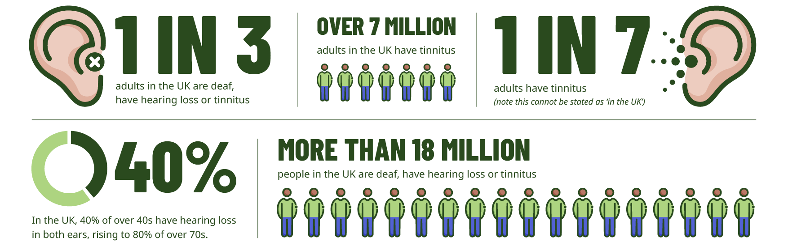
STATISTICS

Slide 5

SIGNS OF HEARING LOSS
Complaining about others mumbling
Don’t react to you
Speaking loudly
Misunderstanding people
Struggling to hear on the telephone
Fail to follow conversation in noisy places
Need to have things repeated several times
Have the TV or radio on very loud

Slide 6
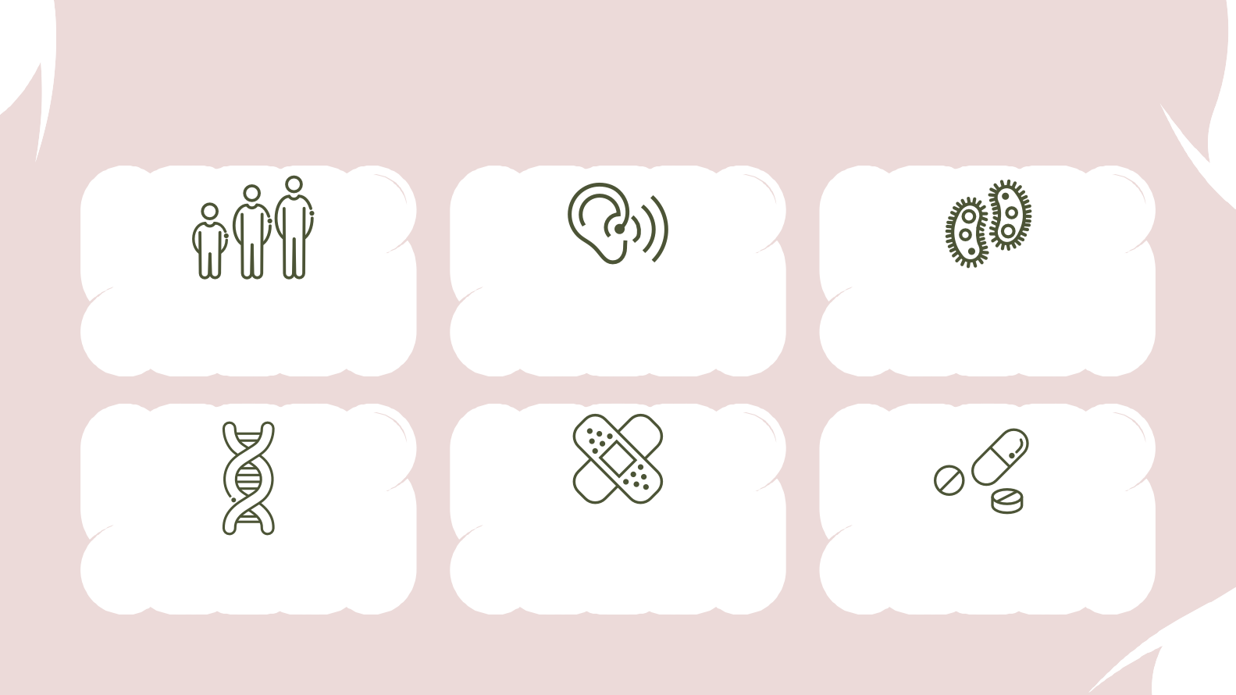
CAUSES
Regular and prolonged exposure to loud noise/sudden loud noise (explosion, etc.)
Certain illnesses– mumps, meningitis, rubella, repeated untreated ear infections, benign tumours on auditory nerve etc..
Age-related hearing loss (presbycusis) – most common
Trauma- head injury, premature birth/difficult labour
Certain drugs – aspirin, cancer treatment, certain antibiotics
1/2 of all childhood deafness is inherited

Slide 7
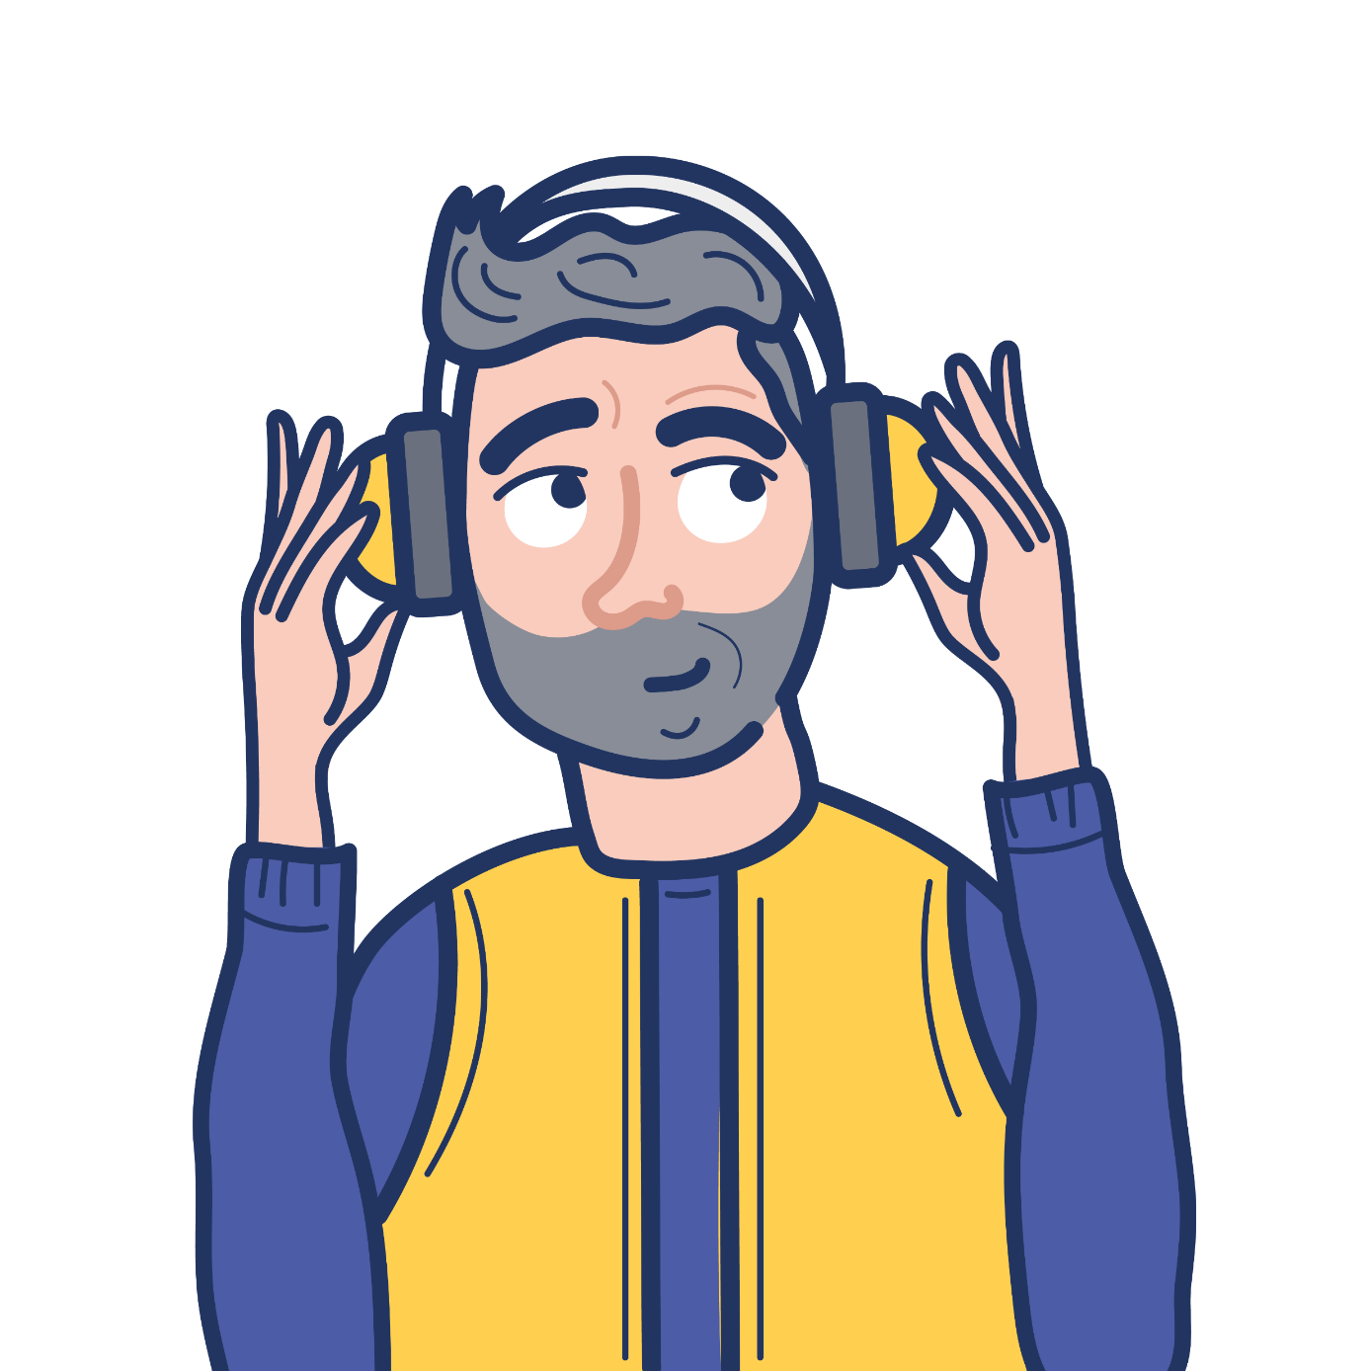
PROTECTING HEARING
Protecting your ears from loud noise can help to prevent hearing loss and tinnitus caused by noise exposure.
Things to consider to protect your ears:
    Turning down the volume on personal listening devices
    Using earplugs or ear defenders in noisy environments
    Taking regular breaks from noisy environments or when listening through headphones
    Use ear defenders at work as required – employers are obliged to protect workers hearing in noisy jobs

Slide 8


COMMUNICATION TIPS
01.
02.
Get my
attention
Face me
Use simple gestures like waving to get my attention.
Please face me when you talk to me. Lots of people rely on lipreading to some degree to understand

Slide 9



COMMUNICATION TIPS
03.
04.
Be
patient
And
never say
Don’t be afraid to repeat or rephrase and try something different

Slide 10
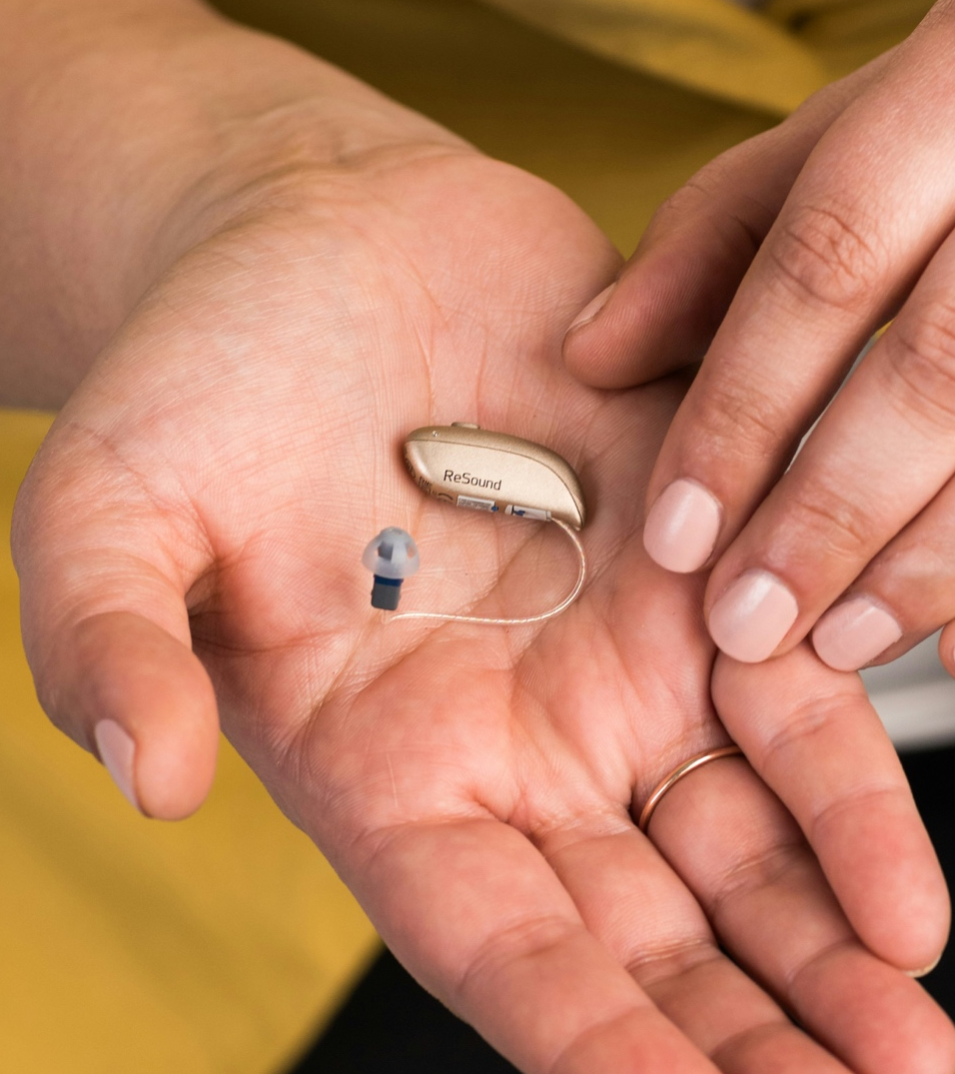
HEARING AIDS
Hearing aids are the most common option provided to help manage hearing loss. Sometimes, hearing aids can help make tinnitus less noticeable, too.
They come in different shapes and sizes, but all work in a similar way – using microphones to pick up noises and adjust the sounds digitally, specially programmed to match the results of hearing tests.
Modern, good quality hearing aids for free on the NHS. Hearing aids can also be bought from private audiology services.

Slide 11
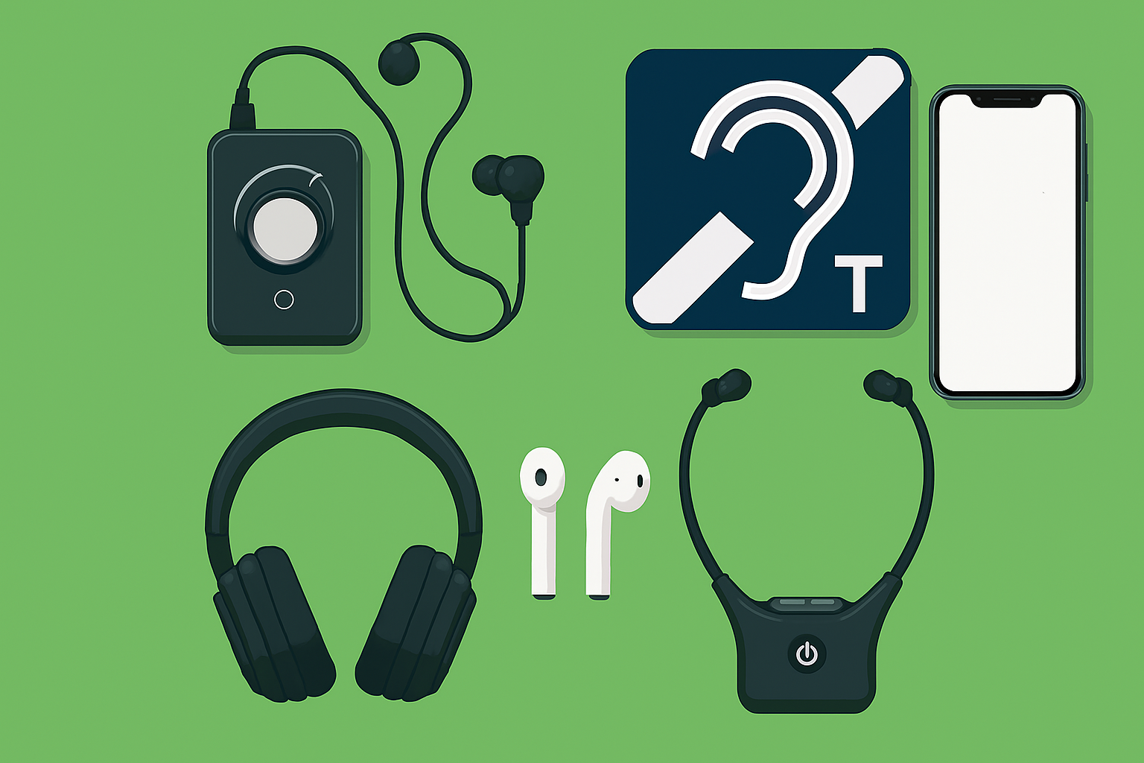
ASSISTIVE TECHNOLOGY
Assistive Listening
Alerting & Monitoring
Hearing Loops
Headphones and Hearables
Auracast
Mobile Apps
Where to buy...
Further information – RNID website
RNID is partnered with Connevans Limited – one of the UK’s leading suppliers of assistive technology
For every purchase made on our joint online shop, RNID receive a 10% donation

Slide 12
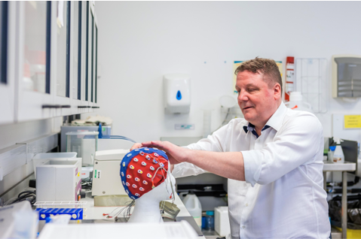
TINNITUS
Tinnitus is the name for hearing noises that are not caused by an outside source.
It’s common – around 1 in 7 adults have tinnitus all the time or regularly.
Many people describe tinnitus as “ringing in the ears” but tinnitus can sound like almost anything.
Many people get tinnitus for a short-time e.g. after being exposed to loud music, but for some people, it doesn’t go away.
The cause of tinnitus isn’t known in all cases, but often linked to hearing loss and some other ear-related conditions. There’s a known link between stress and tinnitus.
Tinnitus is rarely a sign of a serious condition.
There is support and treatment options as well as technology to help manage tinnitus.

Slide 13

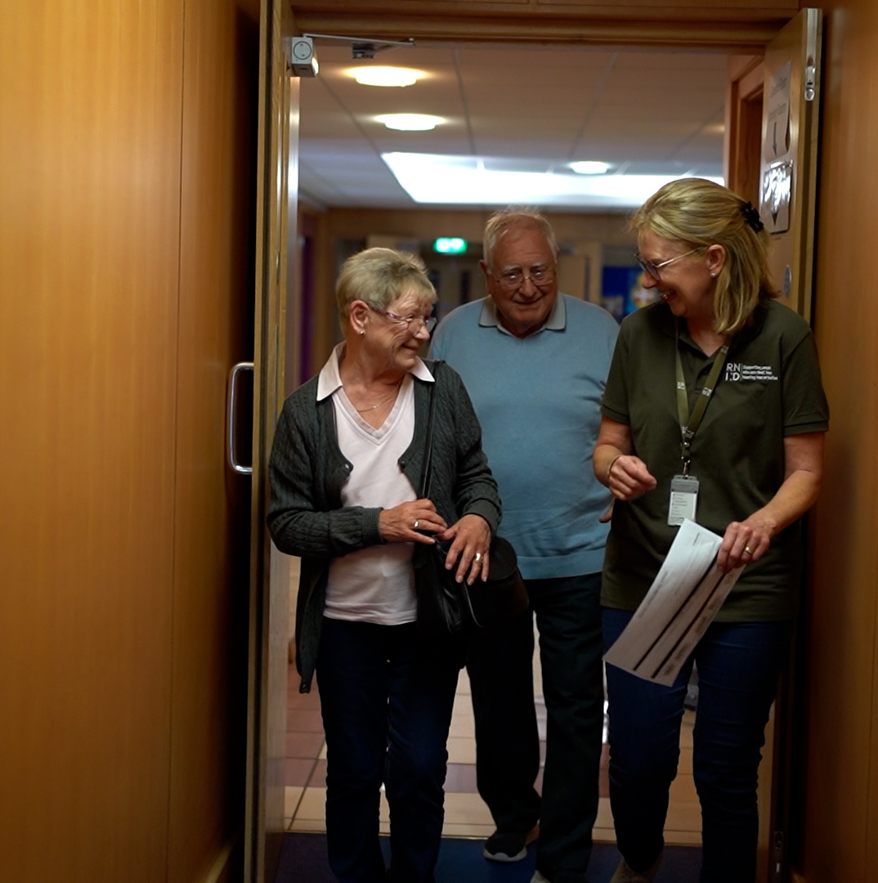
WHAT RNID DO

Slide 14

OUR AREAS OF WORK
INCLUSION - We’re working to make life fully inclusive for our communities and transform public understanding and attitudes in
the process.
HEALTH – We’re helping people identify their hearing loss early on, making it easier for them to take action. We’re working with experts and our communities to improve audiology services.
EMPLOYMENT – We’re working to ensure our communities have equal access to rewarding employment, helping business leaders understand how to successfully recruit people into their organisations, and support individuals to excel when they get there.

Slide 15

IT DOES MATTER CAMPAIGN
Our research found that two thirds of people who are deaf or have hearing loss have experienced negative attitudes or behaviours from the public.
Over half the people who took part in our research reported regularly being excluded from conversations, with people saying “It doesn’t matter” when they struggle to understand what is being said.
The way deaf people and people with hearing loss are valued and supported really does matter. On our website you can sign up to receive our free simple British Sign Language (BSL) videos and communications tips.

Slide 16
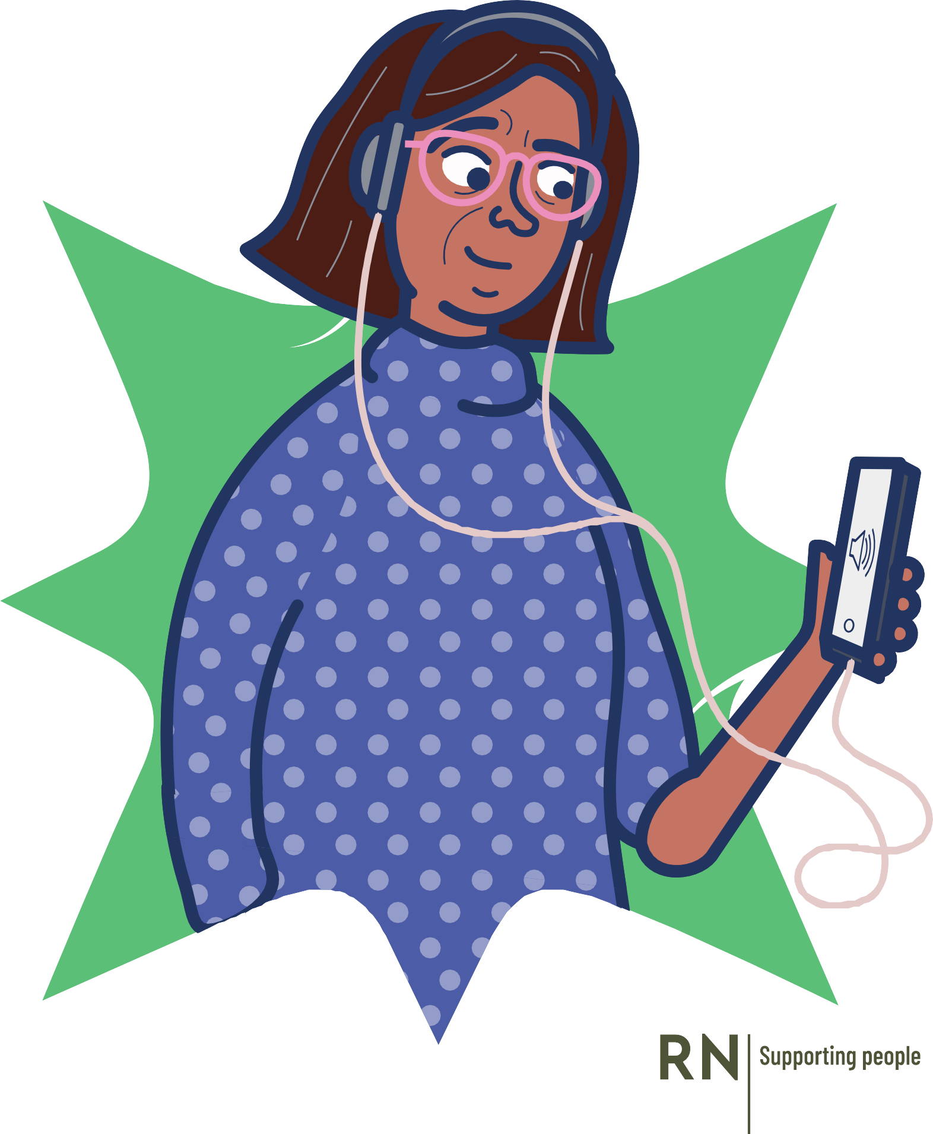
TAKE OUR HEARING CHECK
Check your hearing for free, in just 3 minutes at rnid.org.uk/check
The online hearing check is for people over the age 18 who have not been diagnosed with hearing loss
The check measures how well you can hear speech when there’s background noise
The check will indicate if you need to see someone about your hearing and you will get information on what to do next

Slide 17
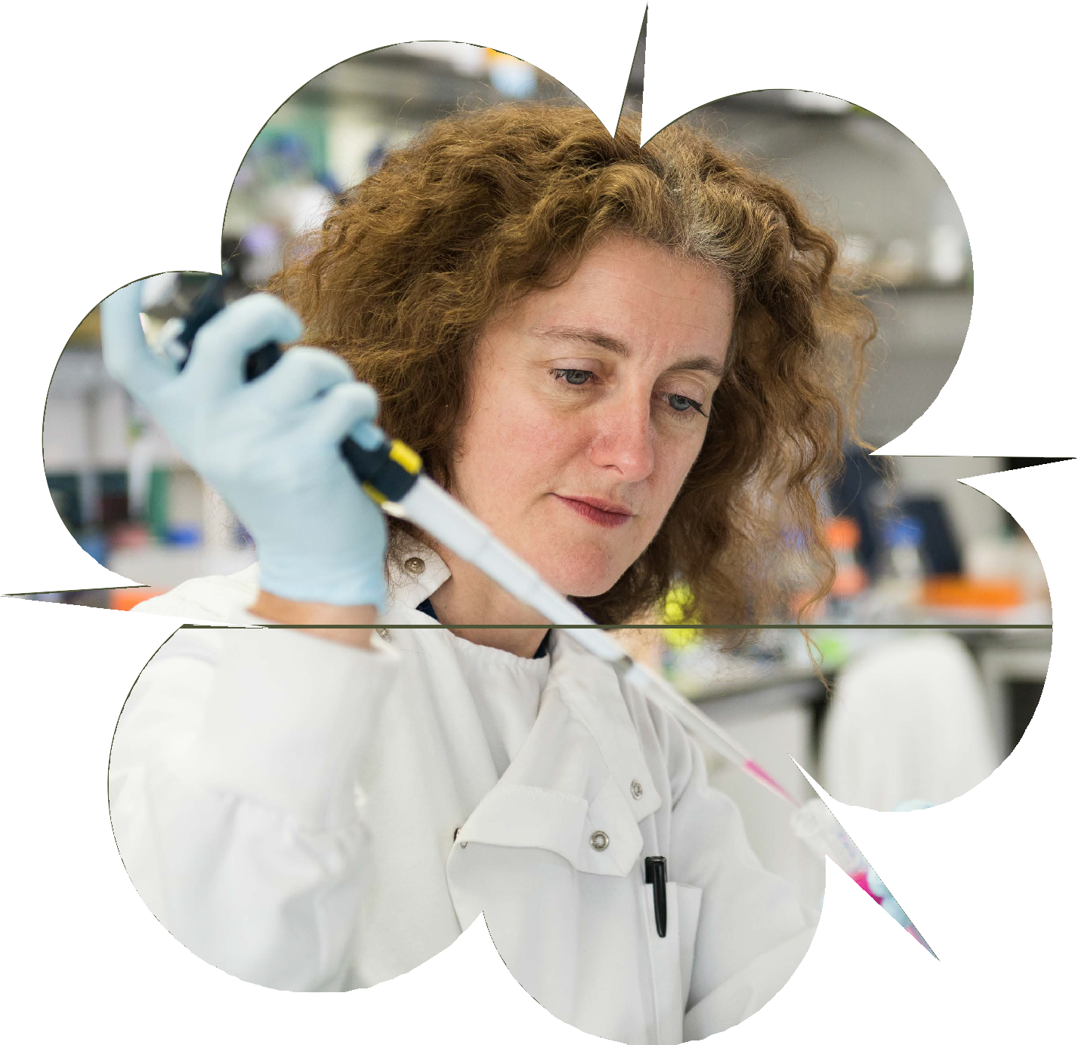

RESEARCH
We are the only charity in the UK dedicated to funding hearing research. Since 2000, we have funded over £28 million of research and supported 443 ground-breaking projects around the world. Our three areas of research focus on:
Restoring hearing
Silencing tinnitus
Preventing hearing loss

Slide 18
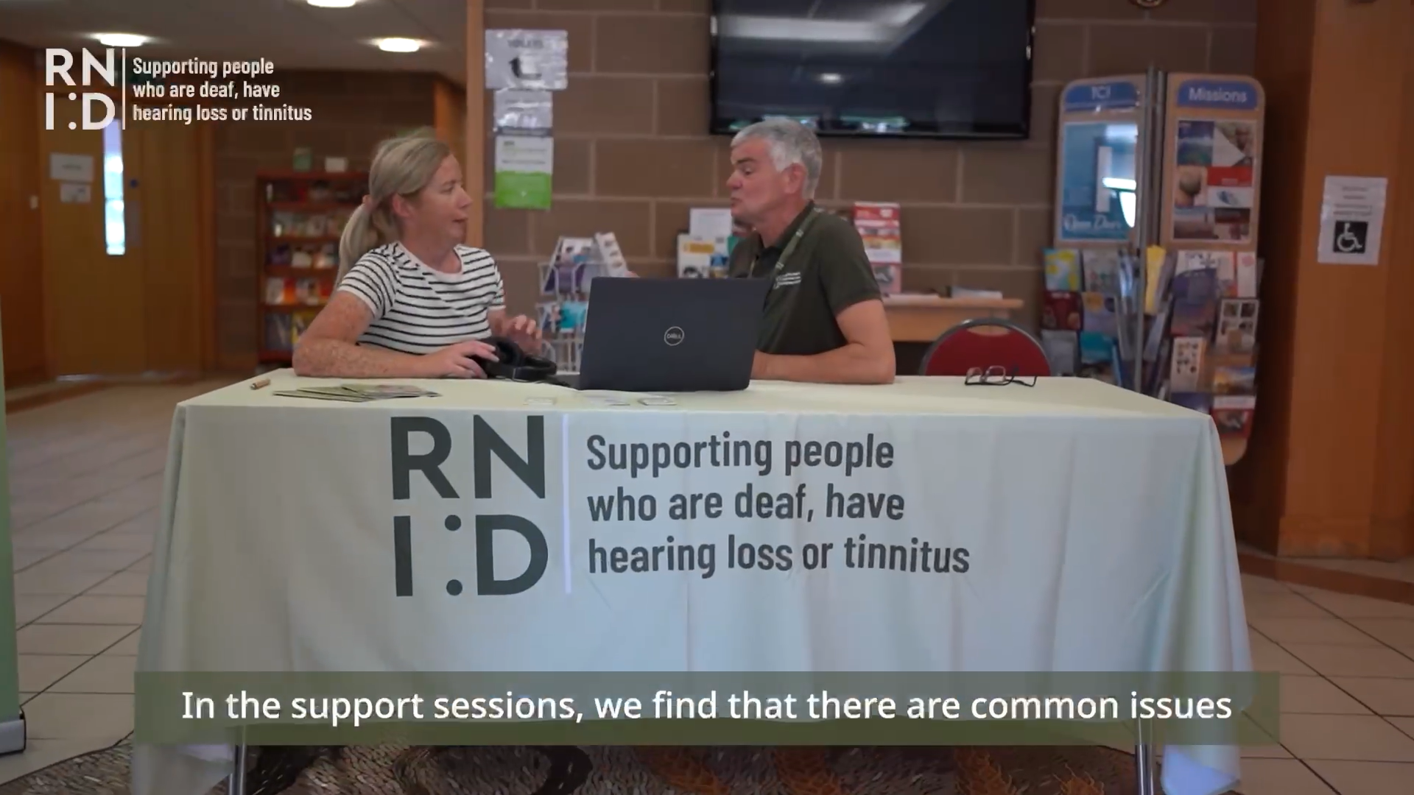



RNID NEAR YOU
RNID Near You can be found in community venues and sometimes as ‘pop-up’ spaces appearing on a temporary basis on a high street or in a shopping centre. We can support with:
Maintenance and re-tubing of NHS hearing aids, replacement batteries
Information and support on managing hearing loss and hearing aids
Signposting to other support services
Hearing checks

Slide 19
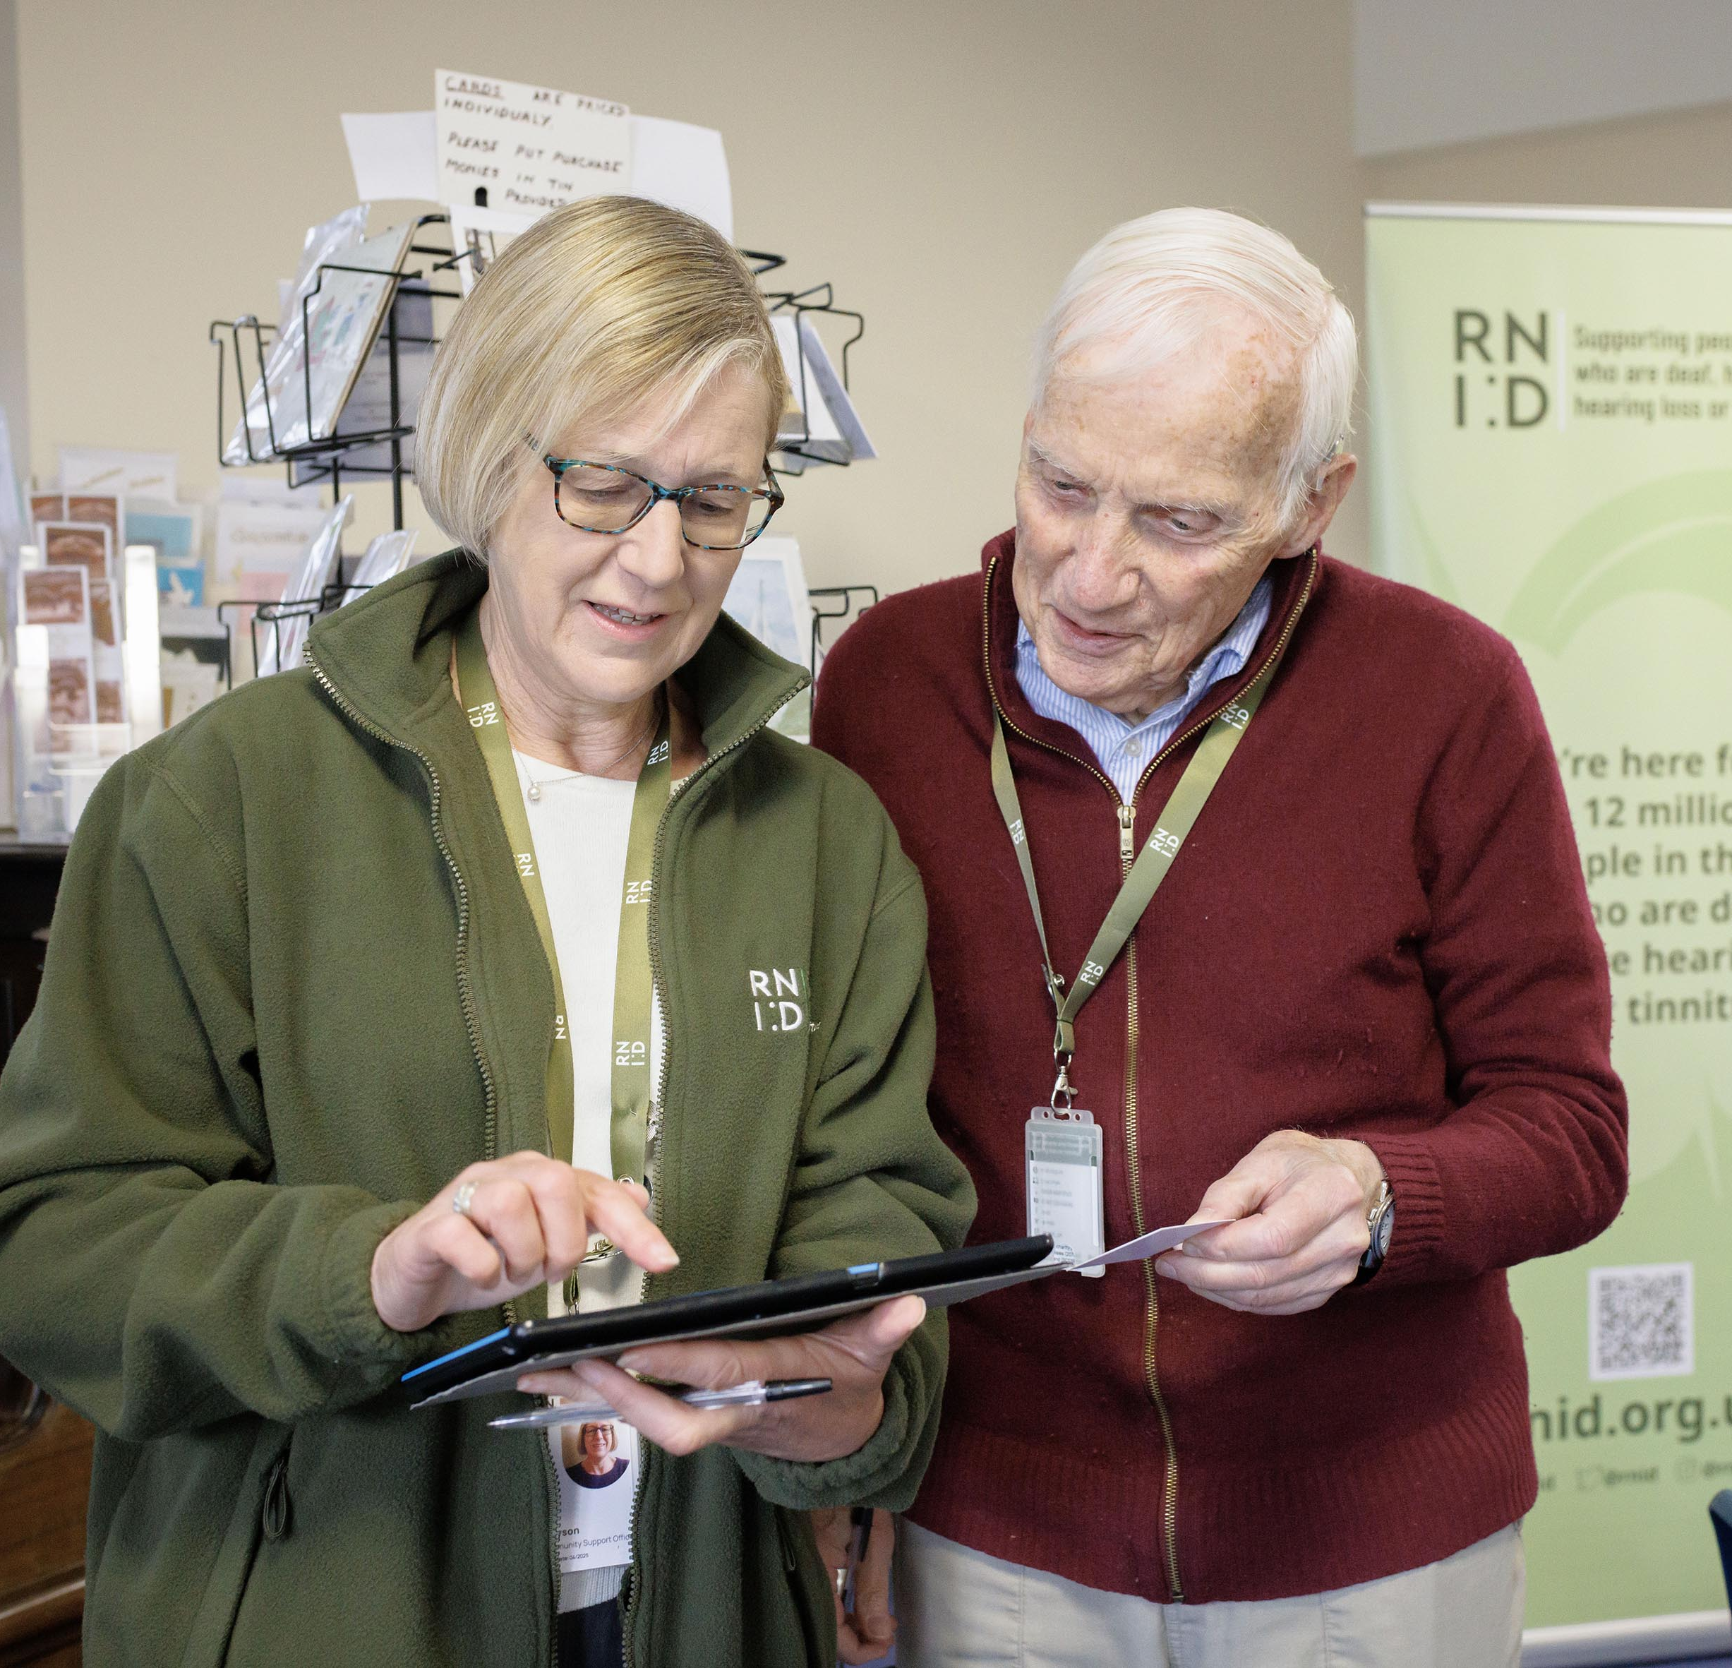
CONTACT RNID
Free, confidential and impartial service, Monday to Friday, 8.30am to 5pm.
Chat to us on the RNID website: www.rnid.org.uk
Call: 0808 808 0123
Email: contact@rnid.org.uk
Book a BSL video call via our partners at : create an account at the Convo website or download the Convo app for Android or the Convo app for IOS
SMS/text: 07360 268988
Relay UK: 18001 then 0808 808 0123
Write: RNID, York House, Wetherby Road, York, YO26 7NH

Slide 20

GET INVOLVED
VOLUNTEER - there are several ways to get involved, such as providing support to our communities in person at one of our RNID Near You sessions.
JOIN#TEAMRNID - Take on a challenge or organise an event and have fun while raising funds to support our vital work.
JOIN OUR RESEARCH PANEL - Our Research Panel is a group of people with lived experience and people with close connections to our cause that take part in research on a regular basis.
BECOME A MEMBER - Join RNID and as a member you will receive our magazine three times a year.
CAMPAIGN FOR CHANGE - Join our Campaigns Network!

Slide 21

THANK
YOU
RNID is the trading name of the Royal National Institute for Deaf People (RNID). Registered charity in England and Wales (207720), and Scotland (SCO38926). Registered company in England and Wales (454169). November 2025.

Slide 22
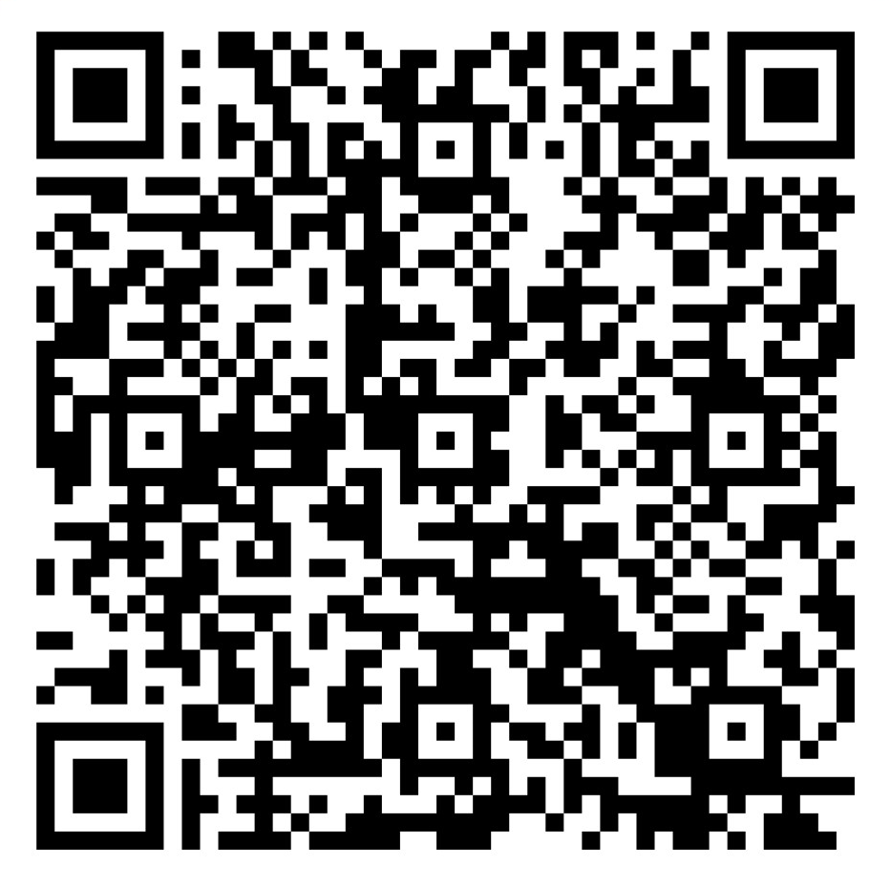
PLEASE SCAN
HERE TO SHARE
YOUR FEEDBACK

