Slide 1
WELCOME
RNID is the national charity supporting more than 18 million people in the UK who are deaf, have hearing loss or tinnitus. We have been helping people with hearing loss for more than 100 years.
We work to make society more inclusive
We provide a free online hearing check, which to-date has been taken by 600,000 people
We are the only UK charity dedicated to funding hearing research
Last year, we supported over 61,000 people either through our contact centre, or in person through RNID Near You sessions across the UK
We have helped change the law around subtitles on TV
If RNID’s work doesn’t directly impact you, it will almost certainly be making a difference for someone you know and love. The charity works with its communities and partners across health, employment, research, government and more to change life for the better

Slide 2



TODAY'S TALK
Hearing loss & Deafness
Communication tips
Technology
Tinnitus
RNID’s work
Get involved!

Slide 3
MY CONNECTION...

Slide 4
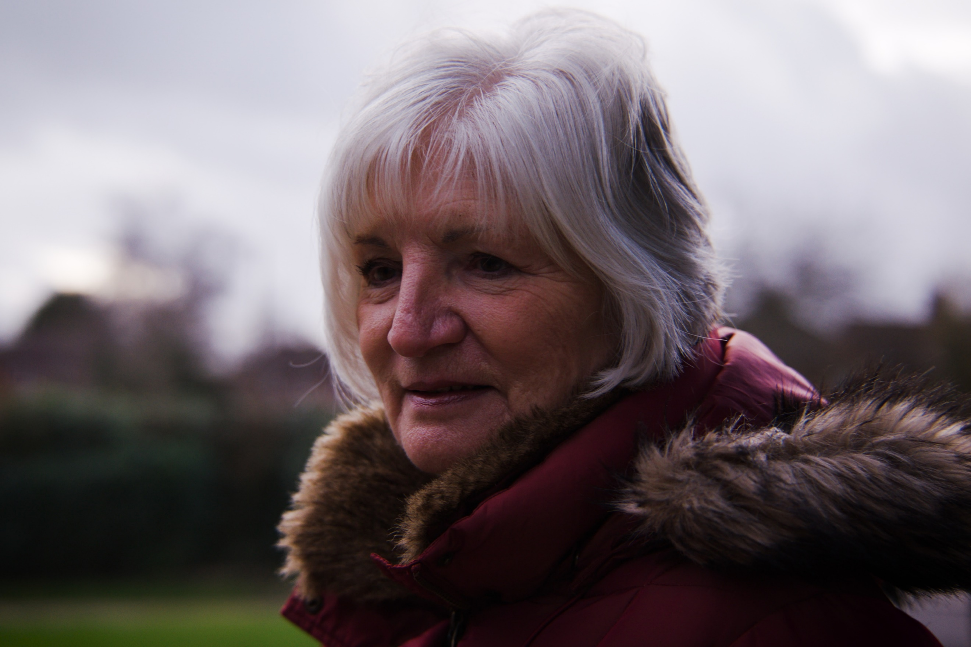
OUR STORIES
“What I’d like to say to people is: if somebody tells you that you might have hearing loss, don’t ignore it.
You mustn’t be defined by your hearing loss, doing so will stop you doing things. Just bite the bullet and get your ears checked.”
- Sheila

Slide 5
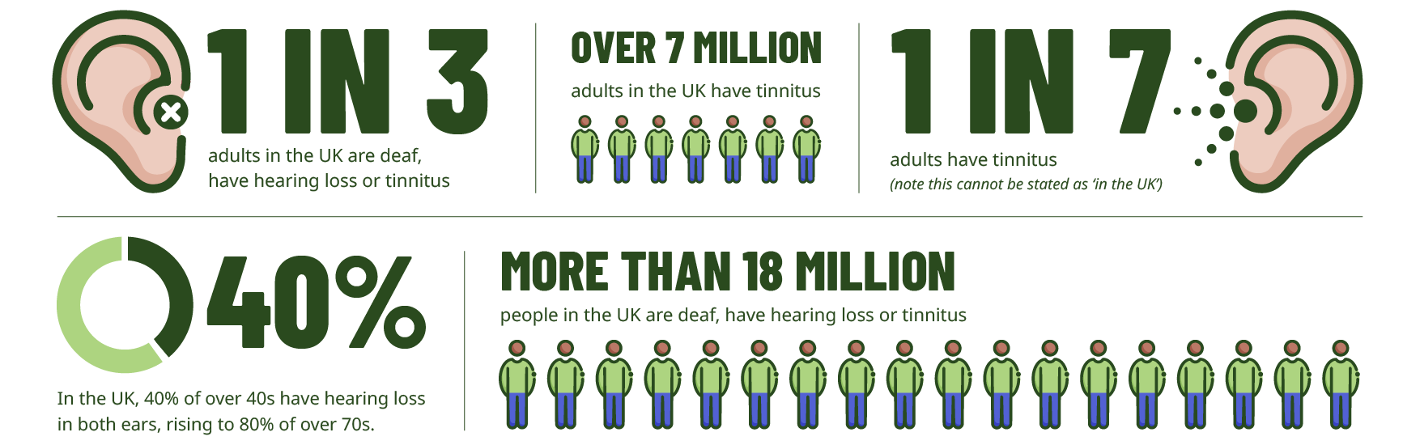
STATISTICS

Slide 6

SIGNS OF HEARING LOSS
Complaining about others mumbling
Don’t react to you
Speaking loudly
Misunderstanding people
Struggling to hear on the telephone
Fail to follow conversation in noisy places
Need to have things repeated several times
Have the TV or radio on very loud

Slide 7
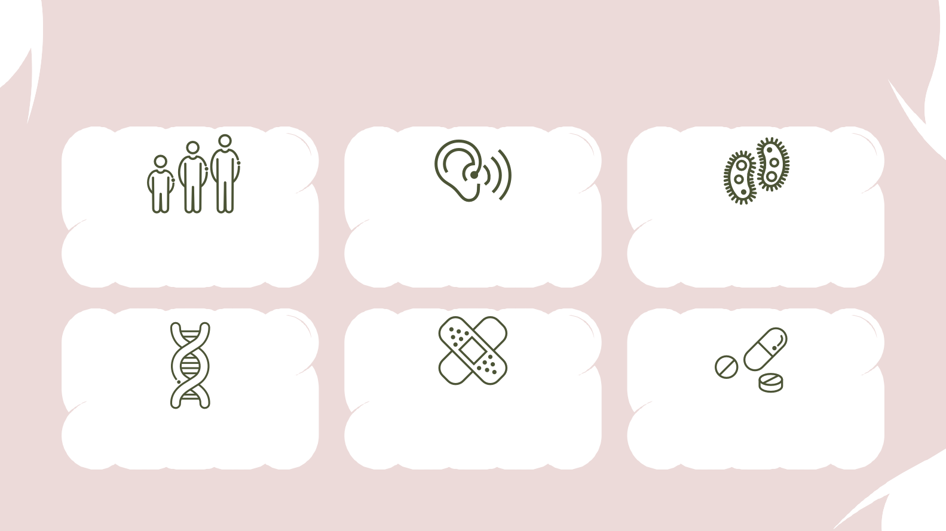
CAUSES
Regular and prolonged exposure to loud noise/sudden loud noise (explosion, etc.)
Certain illnesses– mumps, meningitis, rubella, repeated untreated ear infections, benign tumours on auditory nerve etc..
Age-related hearing loss (presbycusis) – most common
Trauma- head injury, premature birth/difficult labour
Certain drugs – aspirin, cancer treatment, certain antibiotics
1/2 of all childhood deafness is inherited

Slide 8





LEVELS OF HEARING LOSS
A decibel (dB) is a unit for measuring the loudness of sound
MILD
21-40dB
May have difficulty following speech when there is background noise.
May benefit from hearing aids.
MODERATE
40-70dB
May have difficulty following speech in most situations.
Likely to benefit from hearing aids.
SEVERE
71-95dB
Difficulty hearing most sounds or speech.
May use hearing aids, cochlear implants, lipreading, or sign language.
PROFOUND
Over 95dB
Hearing aids or Cochlear Implant to access sound.
May use hearing aids, cochlear implants, lipreading, or sign language.

Slide 9
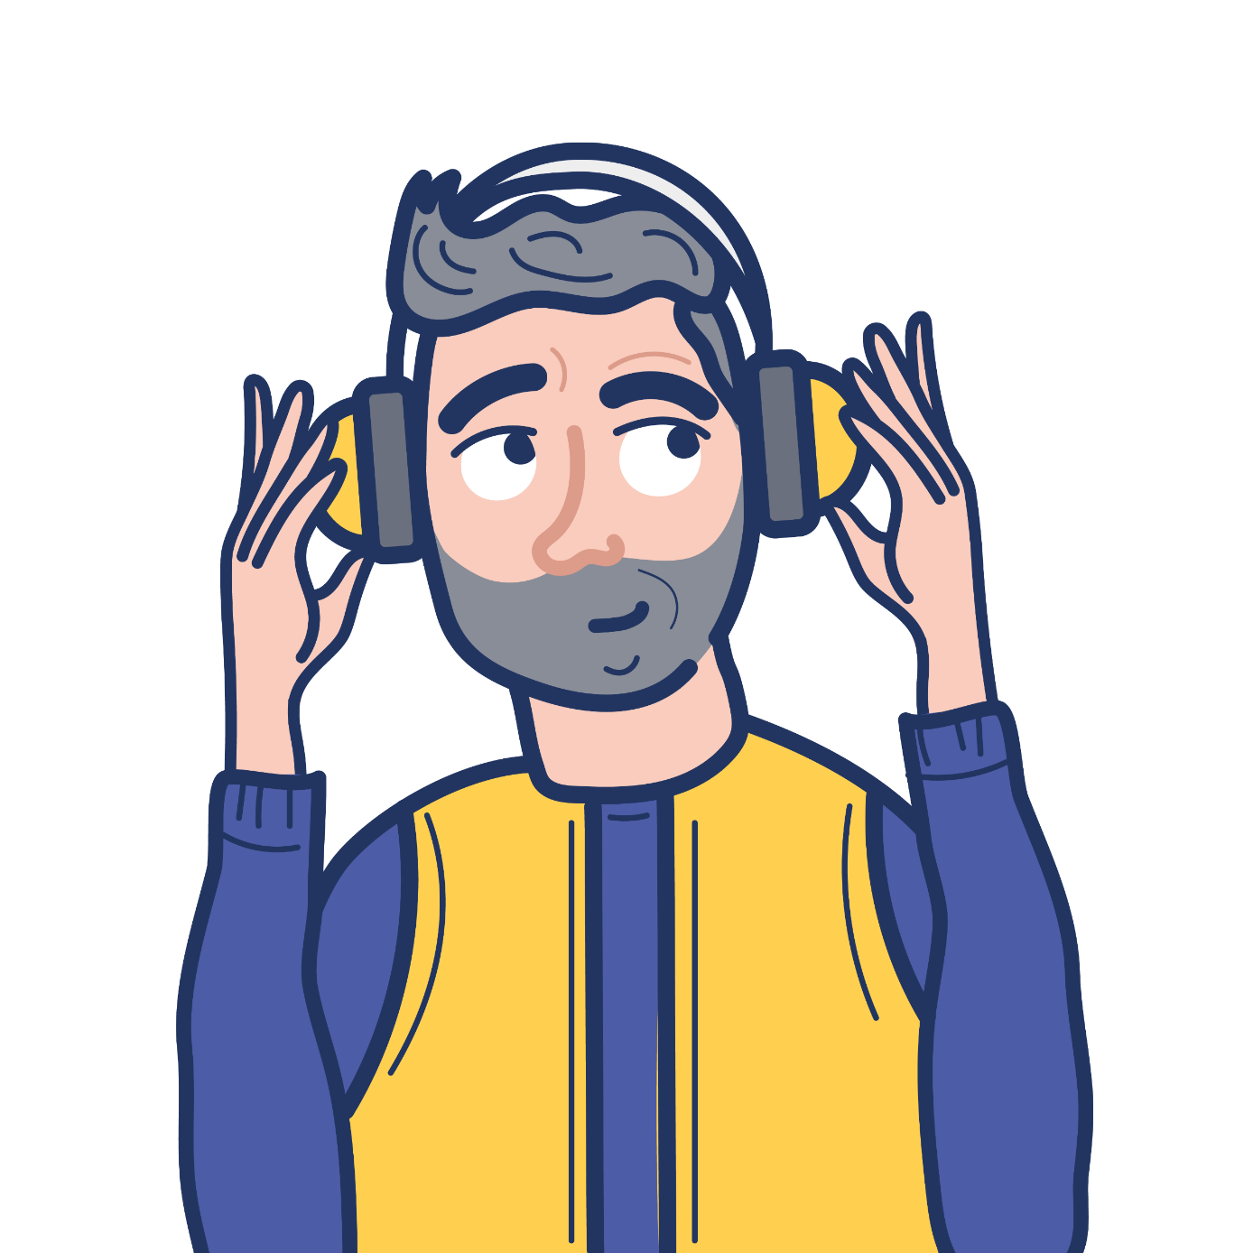
PROTECTING HEARING
Protecting your ears from loud noise can help to prevent hearing loss and tinnitus caused by noise exposure. Things to consider to protect your ears:
    Turning down the volume on personal listening devices
    Using earplugs or ear defenders in noisy environments
    Taking regular breaks from noisy environments or when listening through headphones
    Use ear defenders at work as required – employers are obliged to protect workers hearing in noisy jobs

Slide 10
RECOGNISING AND DESCRIBING HEARING LOSS
There are some indicators that someone may be deaf, for example, not reacting to your voice or another sound
How someone describes their deafness is a personal choice but some terms for guidance:
            Hard of hearing
        Deafened
        Deaf
        There are different communication methods, depending on type of deafness and communication preferences

Slide 11


COMMUNICATION TIPS
01.
02.
Get my
attention
Face me
Use simple gestures like waving to get my attention.
Please face me when you talk to me. Lots of people rely on lipreading to some degree to understand

Slide 12



COMMUNICATION TIPS
03.
04.
Be
patient
And
never say
Don’t be afraid to repeat or rephrase and try something different

Slide 13
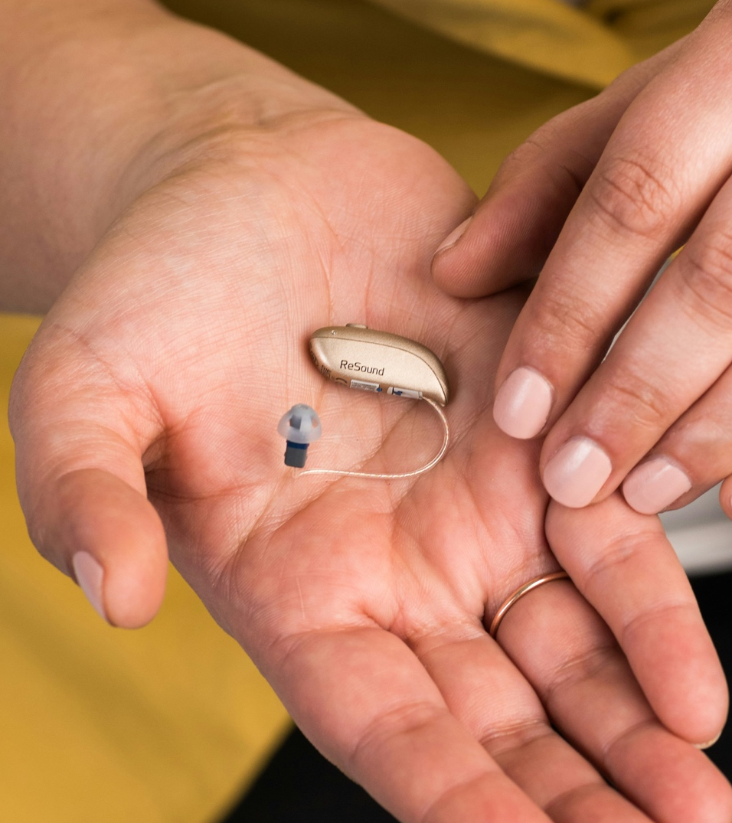
HEARING AIDS
Hearing aids are the most common option provided to help manage hearing loss. Sometimes, hearing aids can help make tinnitus less noticeable, too.
They come in different shapes and sizes, but all work in a similar way – using microphones to pick up noises and adjust the sounds digitally, specially programmed to match the results of hearing tests.

Slide 14

HEARING AIDS
Modern, good quality hearing aids are available for free on the NHS. Hearing aids can also be bought from private audiology services.
Hearing aids can:
make quieter sounds easier to hear
make loud sounds more comfortable
make conversations easier
help you hear on the phone
help you enjoy music, TV and the radio
reduce general background noises.

Slide 15
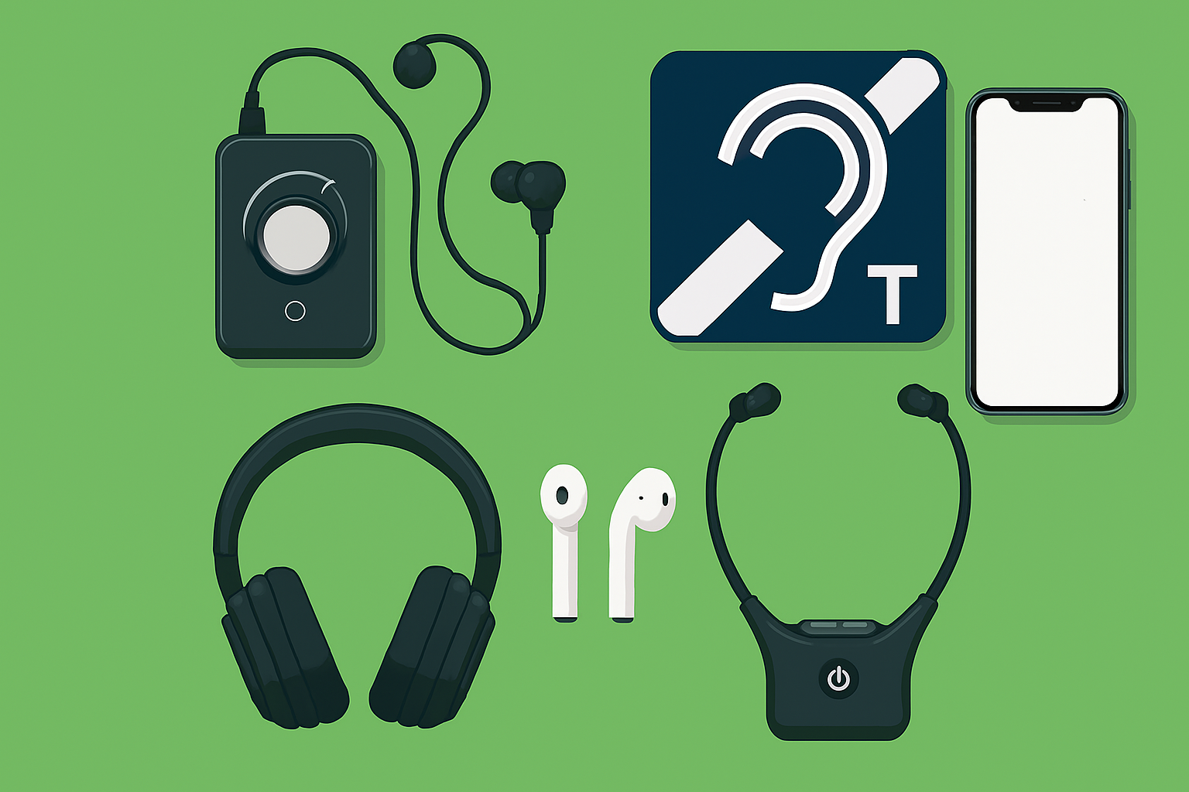
ASSISTIVE TECHNOLOGY
Assistive Listening
Alerting & Monitoring
Hearing Loops
Auracast
Headphones and Hearables
Mobile Apps
Where to buy...
Further information – RNID website
RNID is partnered with Connevans Limited – one of the UK’s leading suppliers of assistive technology
For every purchase made on our joint online shop, RNID receive a 10% donation

Slide 16
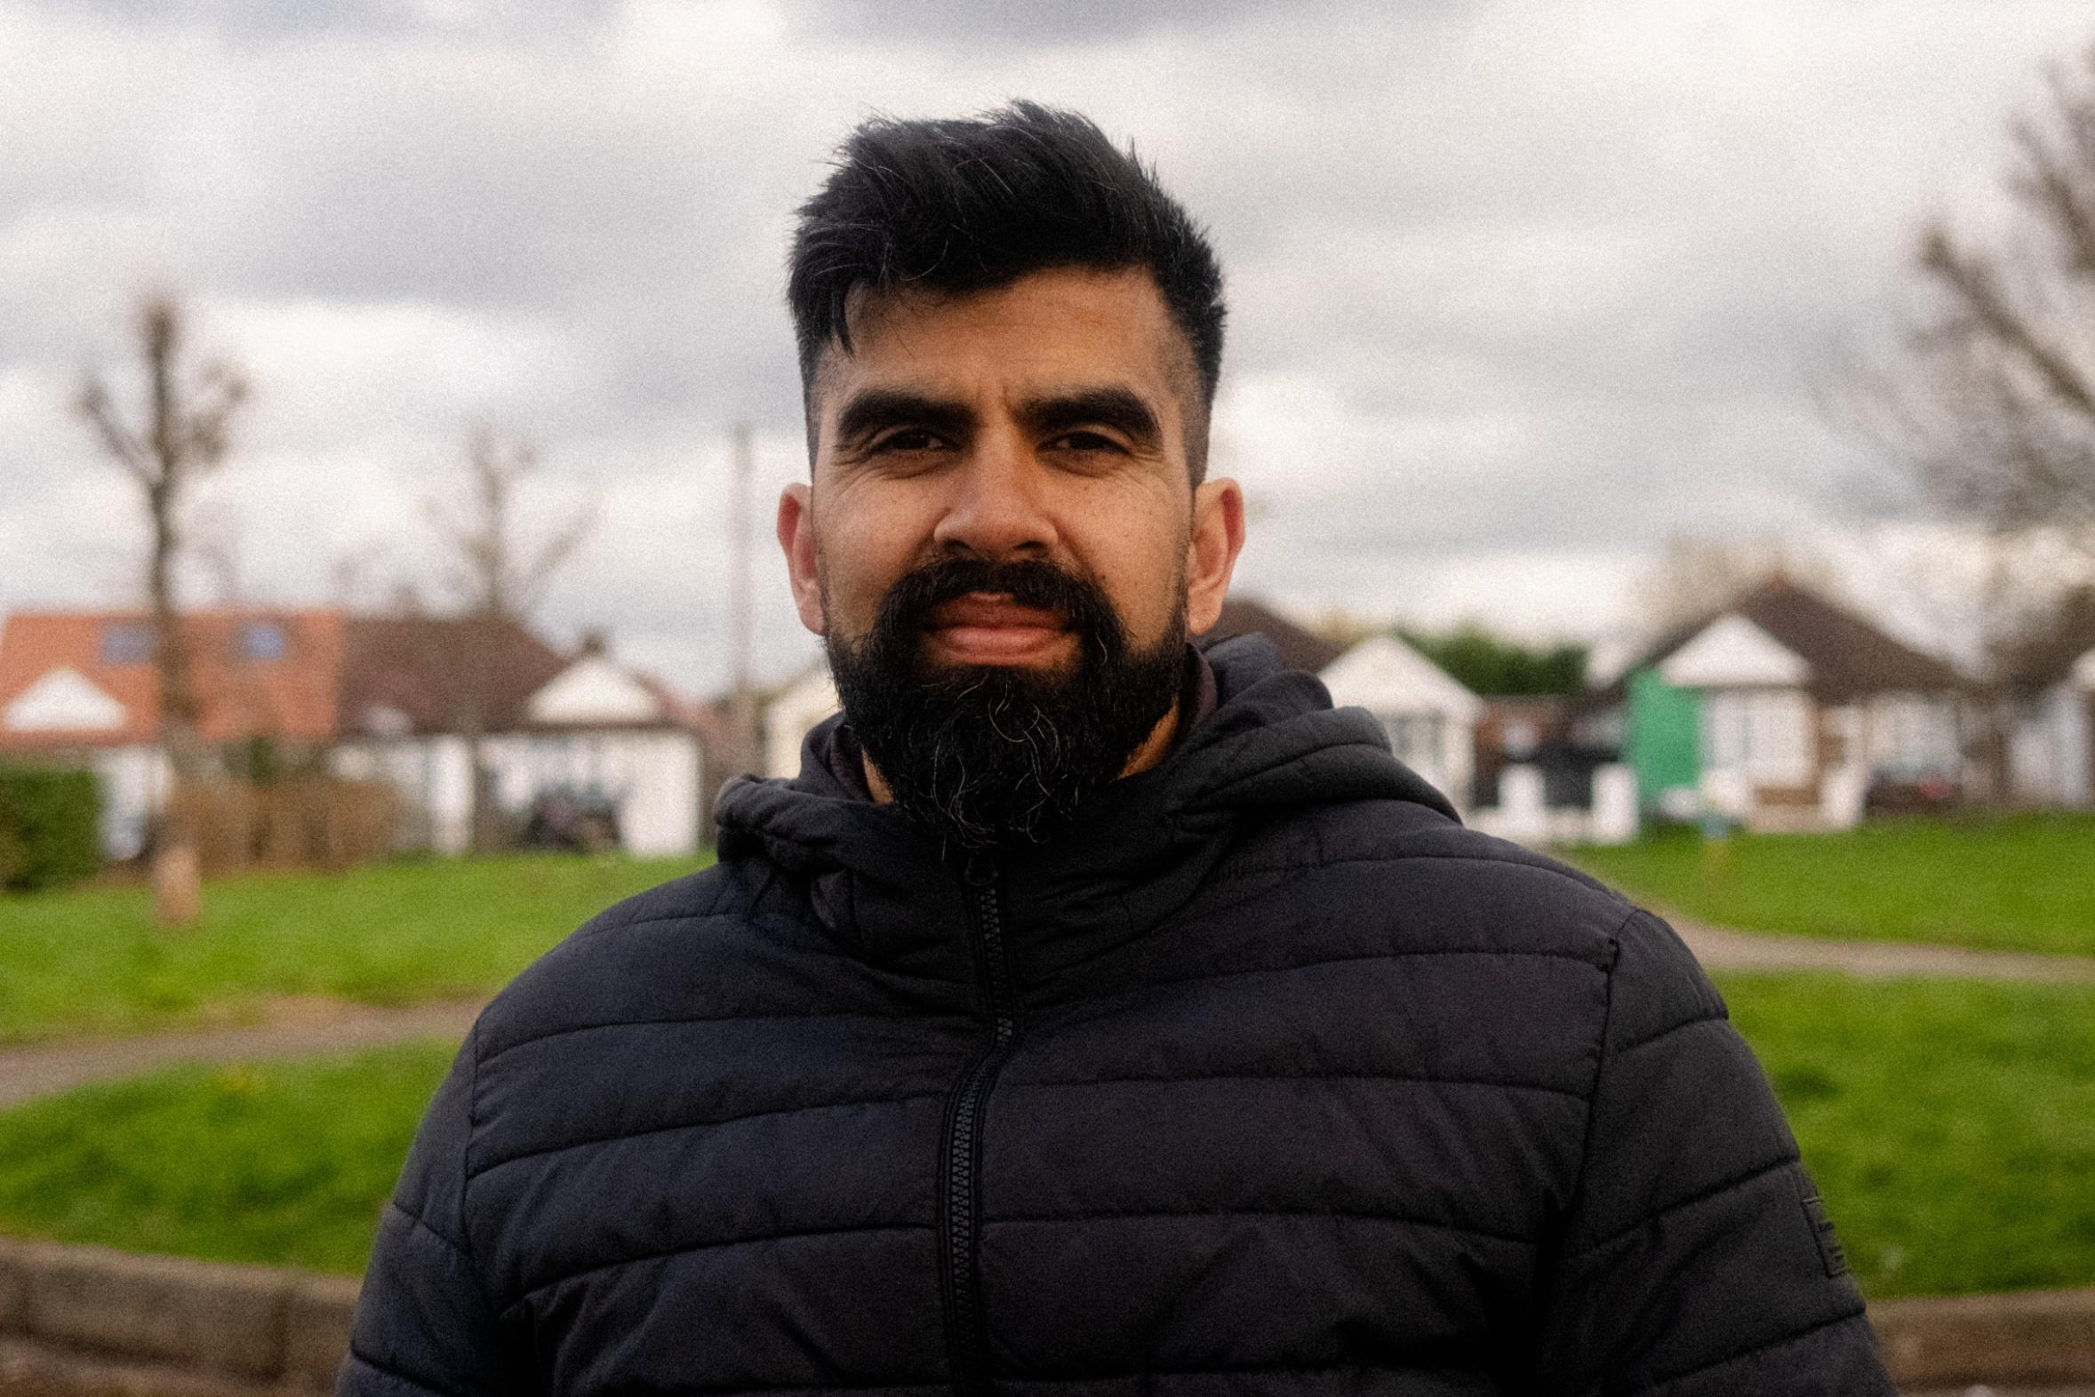
“The day I went to have my hearing aid fitted I felt okay and to be honest was not expecting much in terms of what I’d be able to hear in my left ear.
But my hearing went from 20/30% to 60/70% which is a huge difference. I walked outside and could hear things that I hadn’t really heard in my bad ear like birds and planes in the sky. ”
- Shakib

Slide 17
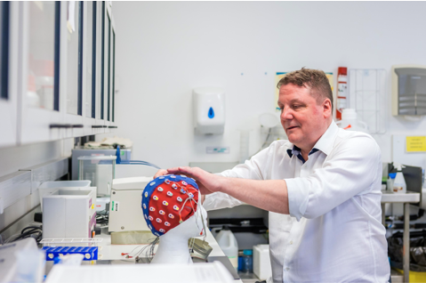
TINNITUS
Tinnitus is the name for hearing noises that are not caused by an outside source.
It’s common – around 1 in 7 adults have tinnitus all the time or regularly.
Many people describe tinnitus as “ringing in the ears”, but tinnitus can sound like almost anything.
Many people get tinnitus for a short-time e.g. after being exposed to loud music, but for some people, it doesn’t go away.
The cause of tinnitus isn’t known in all cases, but it’s often linked to hearing loss and some other ear-related conditions. There’s a known link between stress and tinnitus.
Tinnitus is rarely a sign of a serious condition.
There is support and treatment options as well as technology to help manage tinnitus.

Slide 18

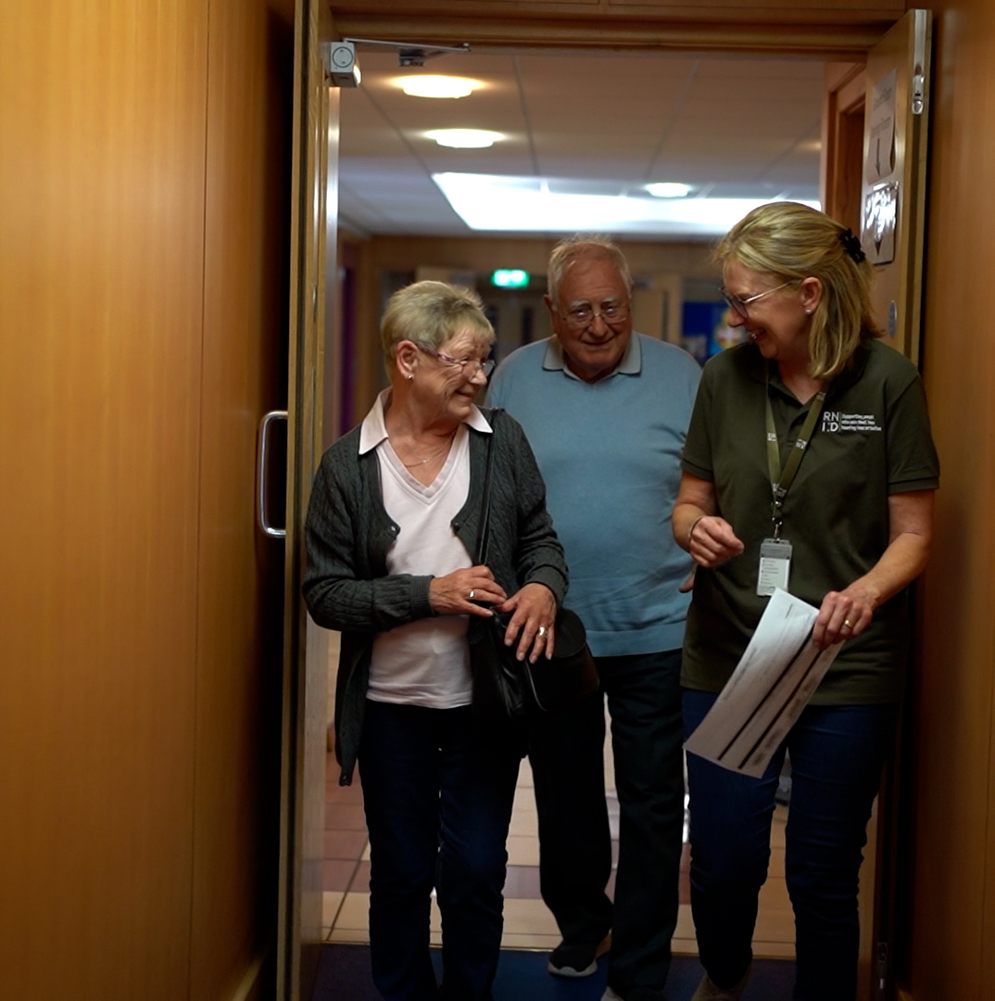
WHAT RNID DO

Slide 19

INCLUSION
Deaf people face barriers in almost every aspect of daily life, from train announcements to job interviews, even the simple act of ordering a takeaway coffee.
Deaf people and those who have hearing loss and tinnitus should enjoy access to the same information, spaces and services as anyone else.
That’s not the case right now. We’ll work
to make life fully inclusive for our communities and transform public understanding and attitudes in
the process.

Slide 20

IT DOES MATTER CAMPAIGN
Our research found that two thirds of people who are deaf or have hearing loss have experienced negative attitudes or behaviours from the public.
Over half the people who took part in our research reported regularly being excluded from conversations, with people saying “It doesn’t matter” when they struggle to understand what is being said.
The way deaf people and people with hearing loss are valued and supported really does matter. On our website you can sign up to receive our free simple British Sign Language (BSL) videos and communications tips.

Slide 21

HEALTH
Looking after your hearing health needs to be high on the national agenda. We want to make checking your hearing as much a part of daily life as having your eyes and teeth checked.
We will work with experts and our communities to improve audiology services, so that from the point people notice their hearing loss or tinnitus they find it easy to get the high-quality healthcare, treatment and support they need.

Slide 22
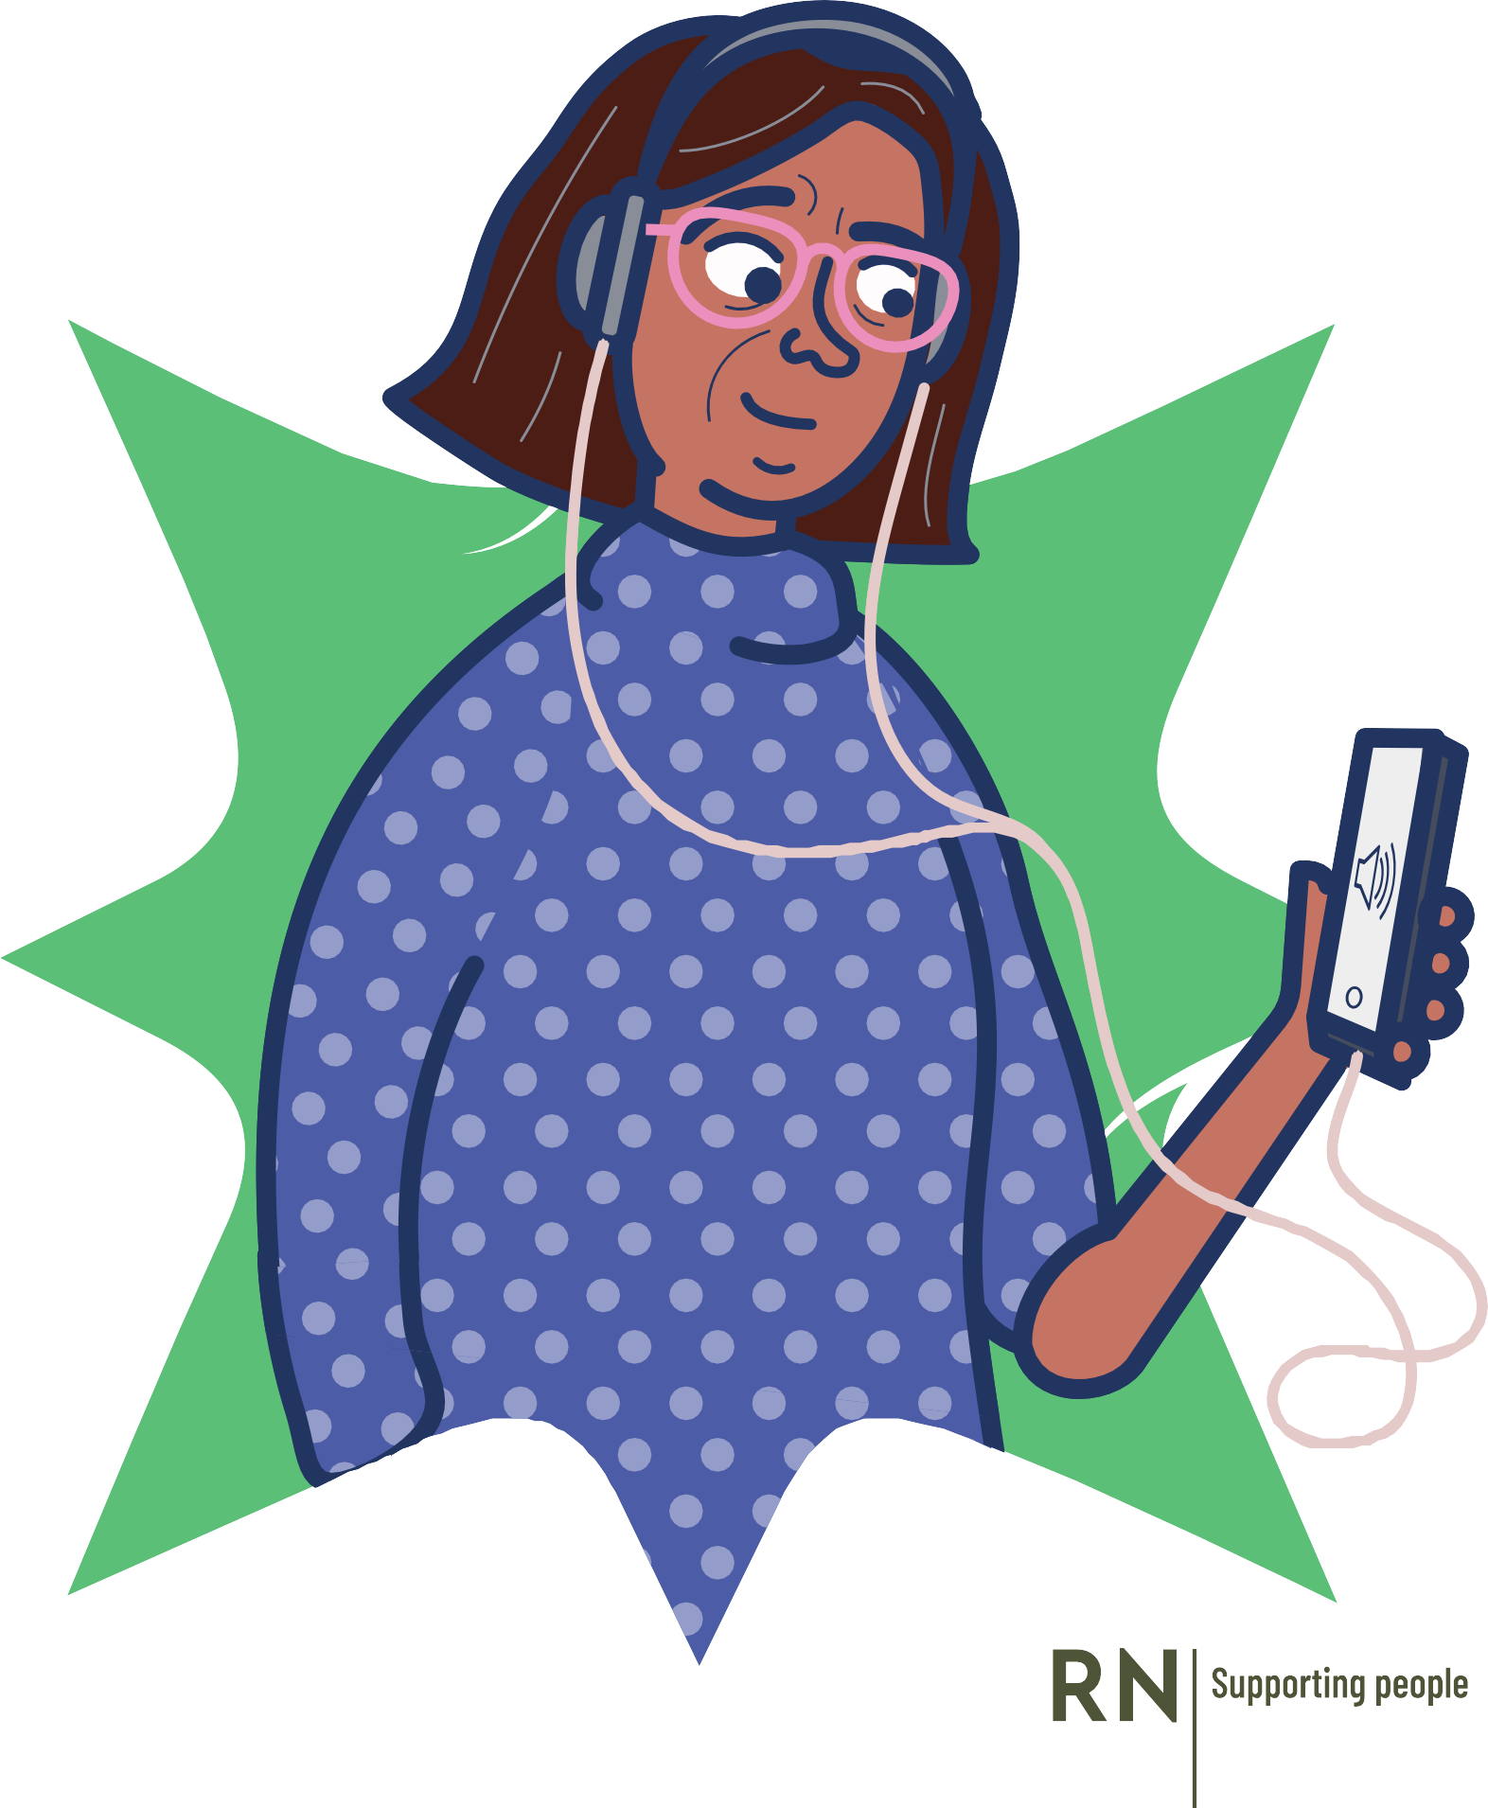
TAKE OUR HEARING CHECK
Check your hearing for free, in just 3 minutes at rnid.org.uk/check
The online hearing check is for people over the age 18 who have not been diagnosed with hearing loss
The check measures how well you can hear speech when there’s background noise
The check will indicate if you need to see someone about your hearing and you will get information on what to do next

Slide 23

EMPLOYMENT
12 million people of working age in the UK have hearing loss. They are less likely to have a job than the rest of the population. When they are in employment, our communities face multiple barriers to succeeding in the workplace, mainly due to lack of support and awareness.
We will work so that our communities have equal access to rewarding employment. We’ll help business leaders understand how to successfully recruit people into their organisations, and support individuals to excel when they get there.

Slide 24
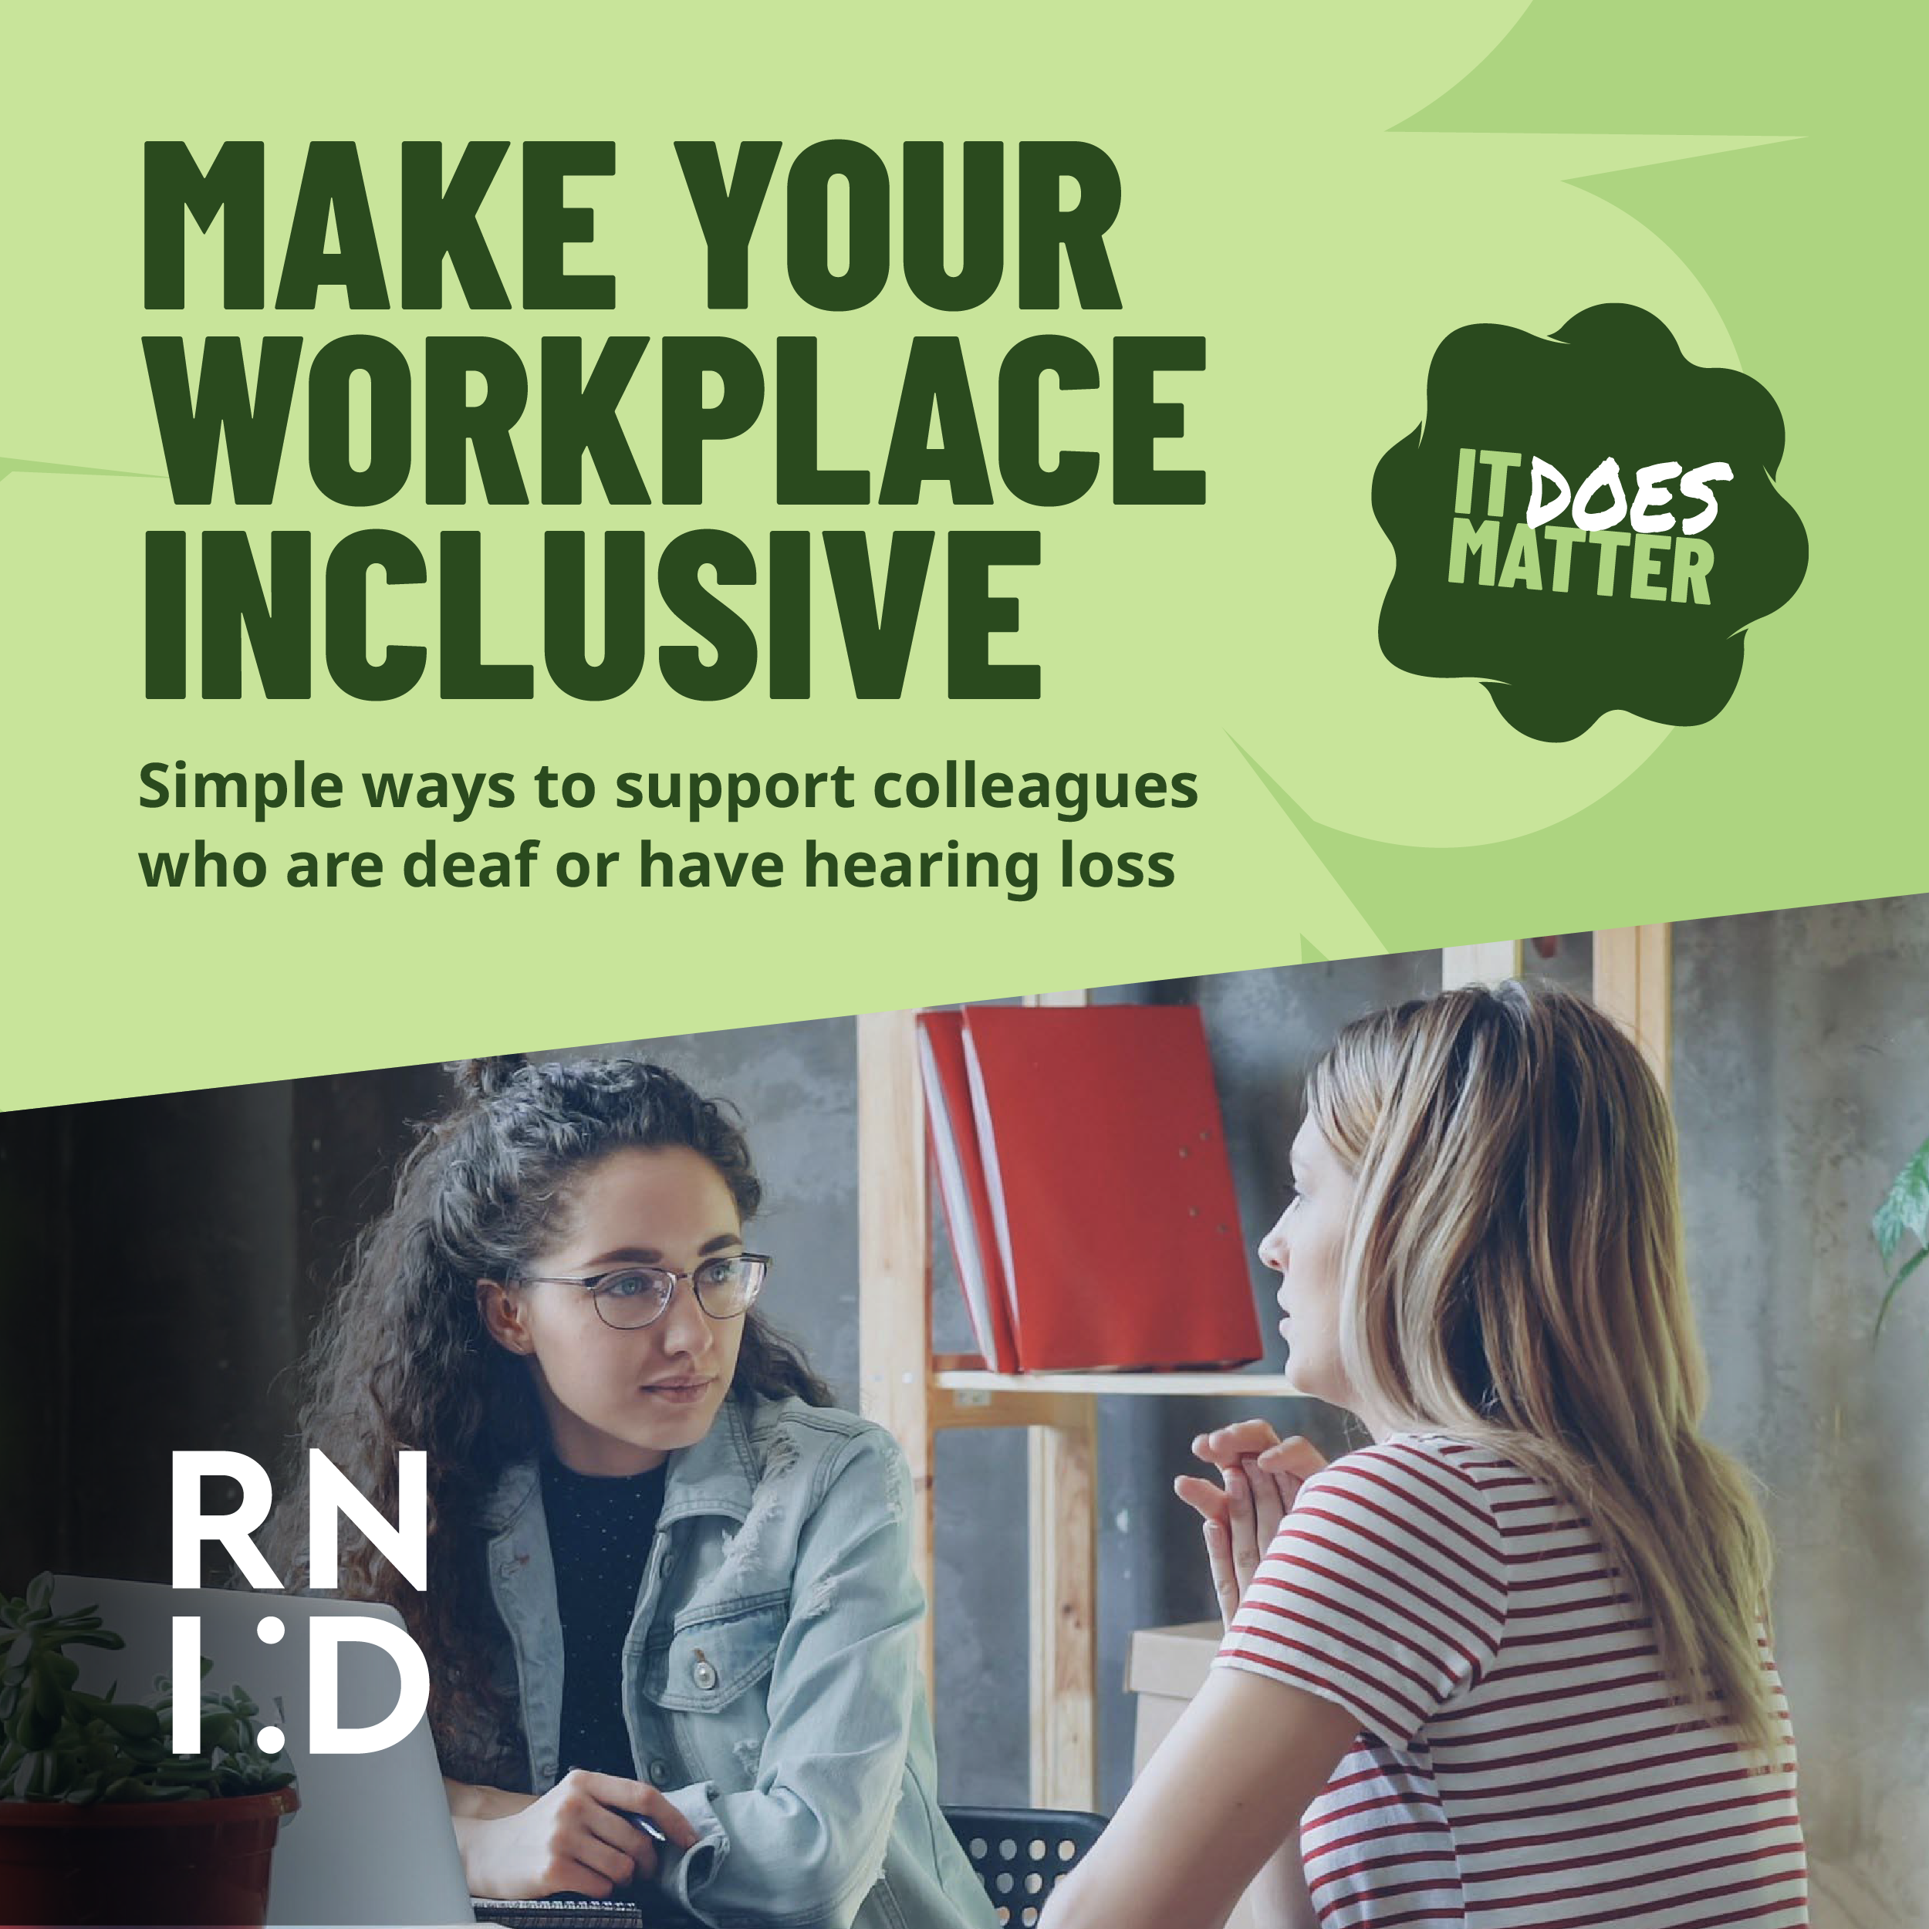
FREE RESOURCES FOR BUSINESSES
Our research shows that people want to communicate with deaf people, but they’re worried about getting it wrong. It’s always better to try than to leave people out of the conversation. Simple changes can make a big difference.
You can sign up on our website to receive free resources to help people become more deaf aware –perfect for Deaf Awareness Week in May, and beyond.
Show that having an inclusive workplace does matter.

Slide 25

“ By pursuing a career in audiology, I have shown that being deaf does not stop you from working in a medical field or achieving your dreams. ”
- Sarah

Slide 26
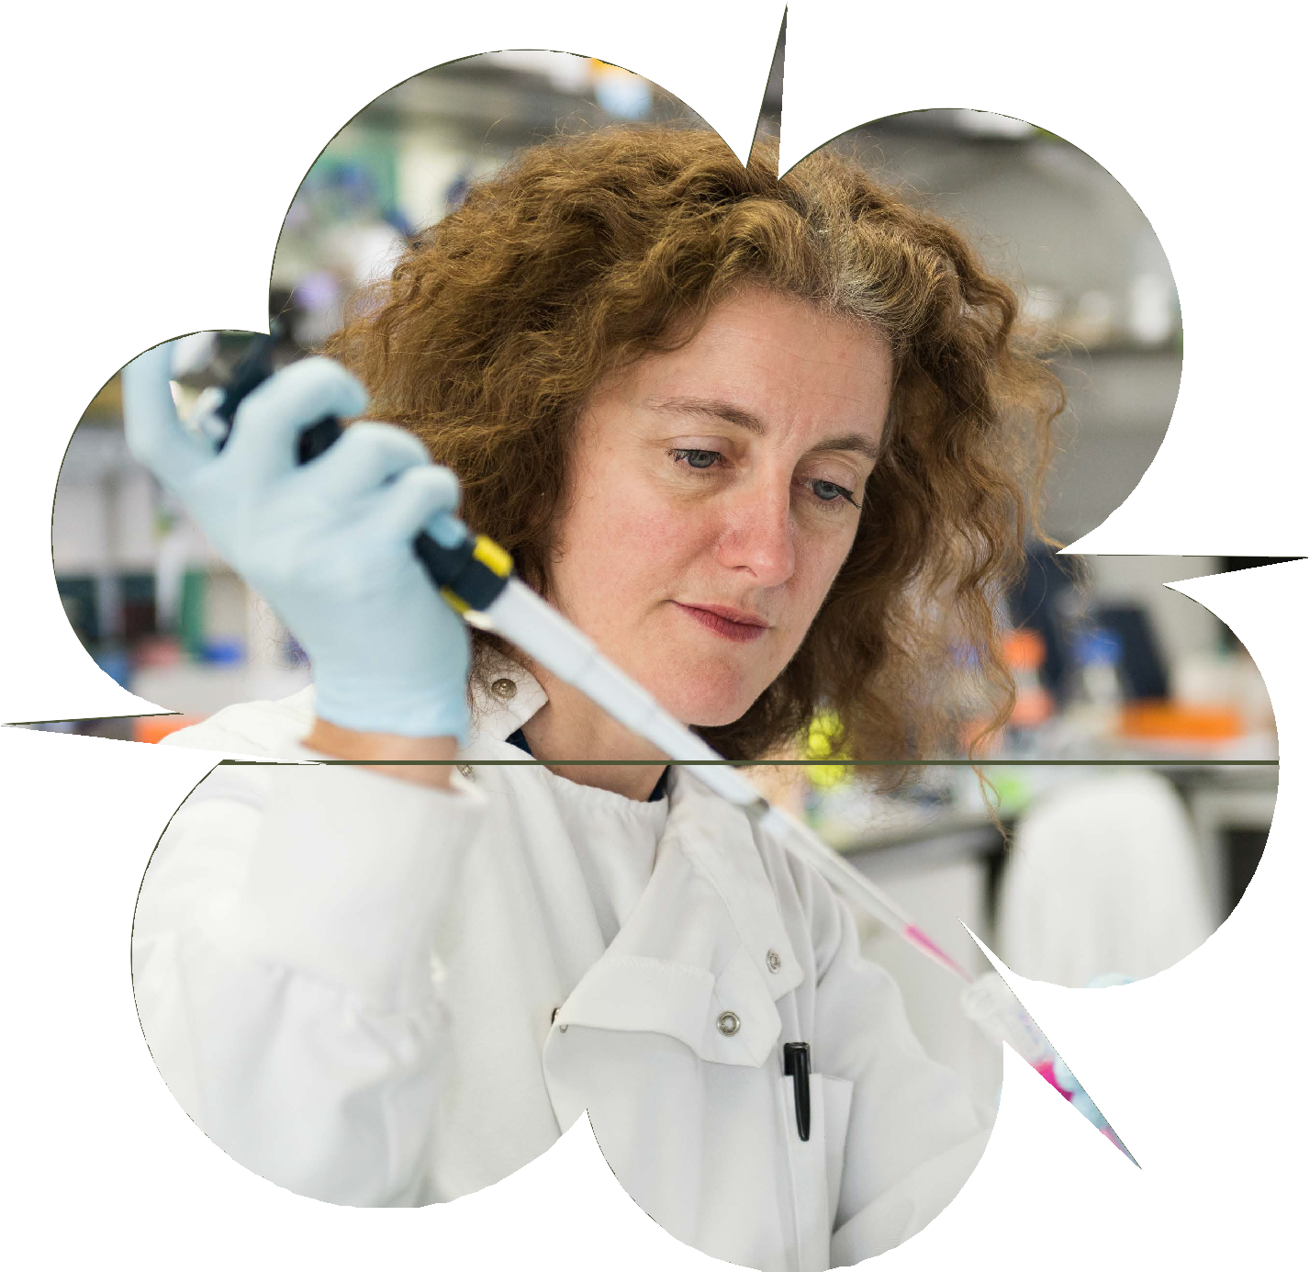

RESEARCH
We are the only charity in the UK dedicated to funding hearing research. Since 2000, we have funded over £28 million of research and supported 443 ground-breaking projects around the world.
Our three areas of research focus on:
Restoring hearing
Silencing tinnitus
Preventing hearing loss

Slide 27
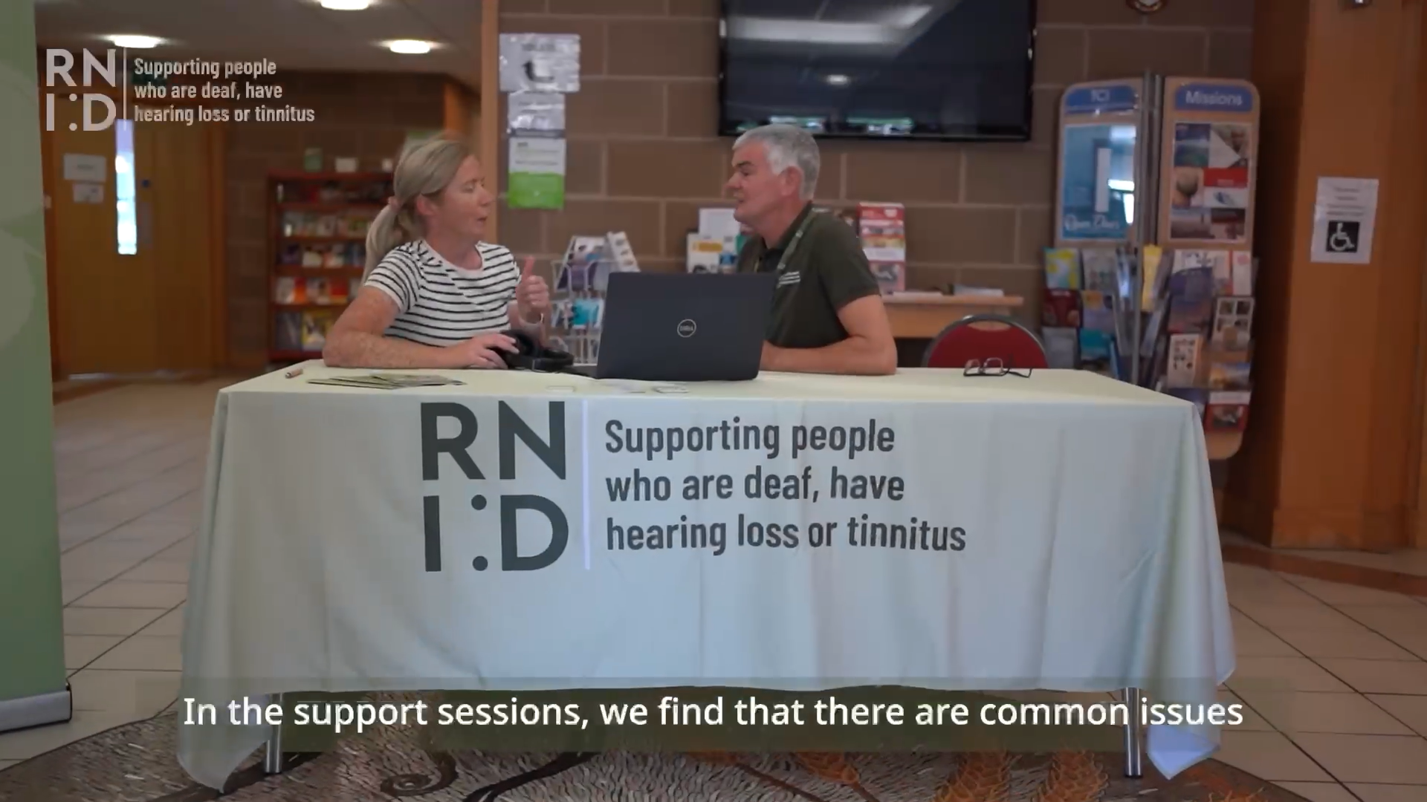



RNID NEAR YOU
RNID Near You can be found in community venues and sometimes as ‘pop-up’ spaces appearing on a temporary basis on a high street or in a shopping centre. We can support with:
Maintenance and re-tubing of NHS hearing aids, replacement batteries
Information and support on managing hearing loss and hearing aids
Signposting to other support services
Hearing checks

Slide 28
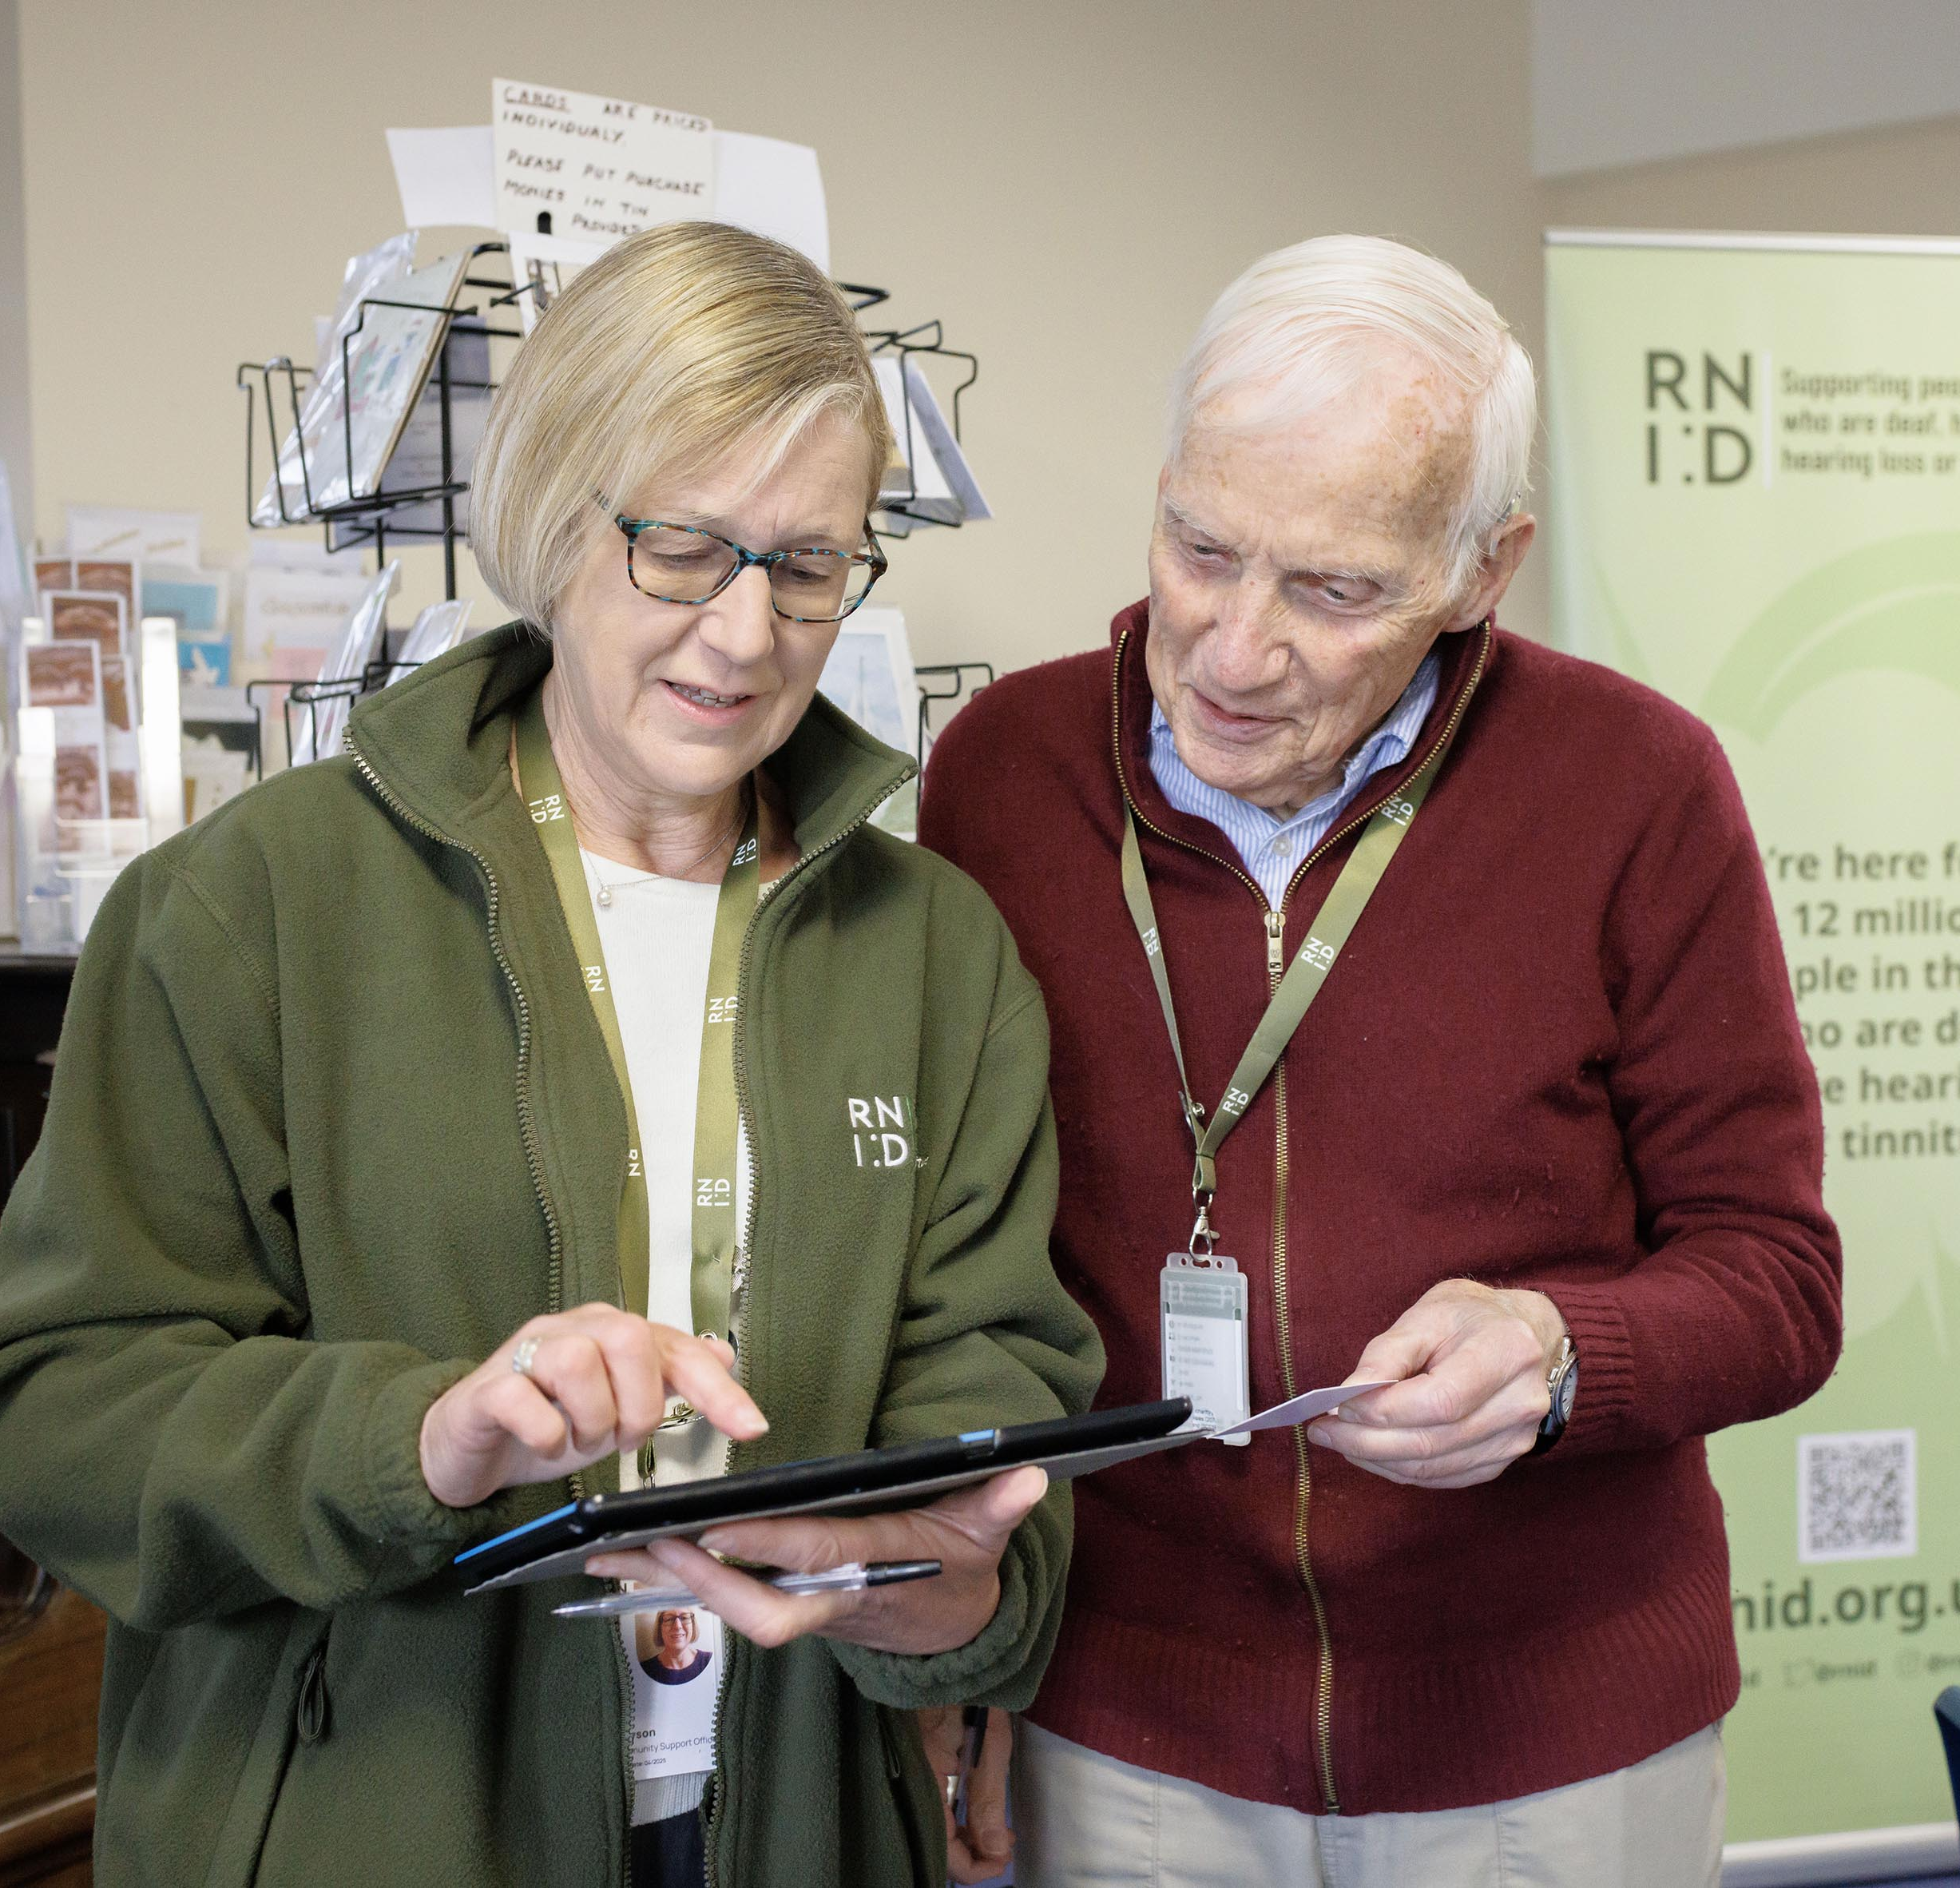
CONTACT RNID
Free, confidential, and impartial service - Monday to Friday, 8.30am to 5pm.
Chat to us on the RNID website: www.rnid.org.uk
Call: 0808 808 0123
Email: contact@rnid.org.uk
Book a BSL video call via our partners at Convo: create an account at the Convo website or download the Convo app for Android or the Convo app for IOS
SMS/text: 07360 268988
Relay UK: 18001 then 0808 808 0123
Write: RNID, York House, Wetherby Road, York, YO26 7NH

Slide 29

GET
INVOLVED!
There are many ways you can make a difference:

Slide 30
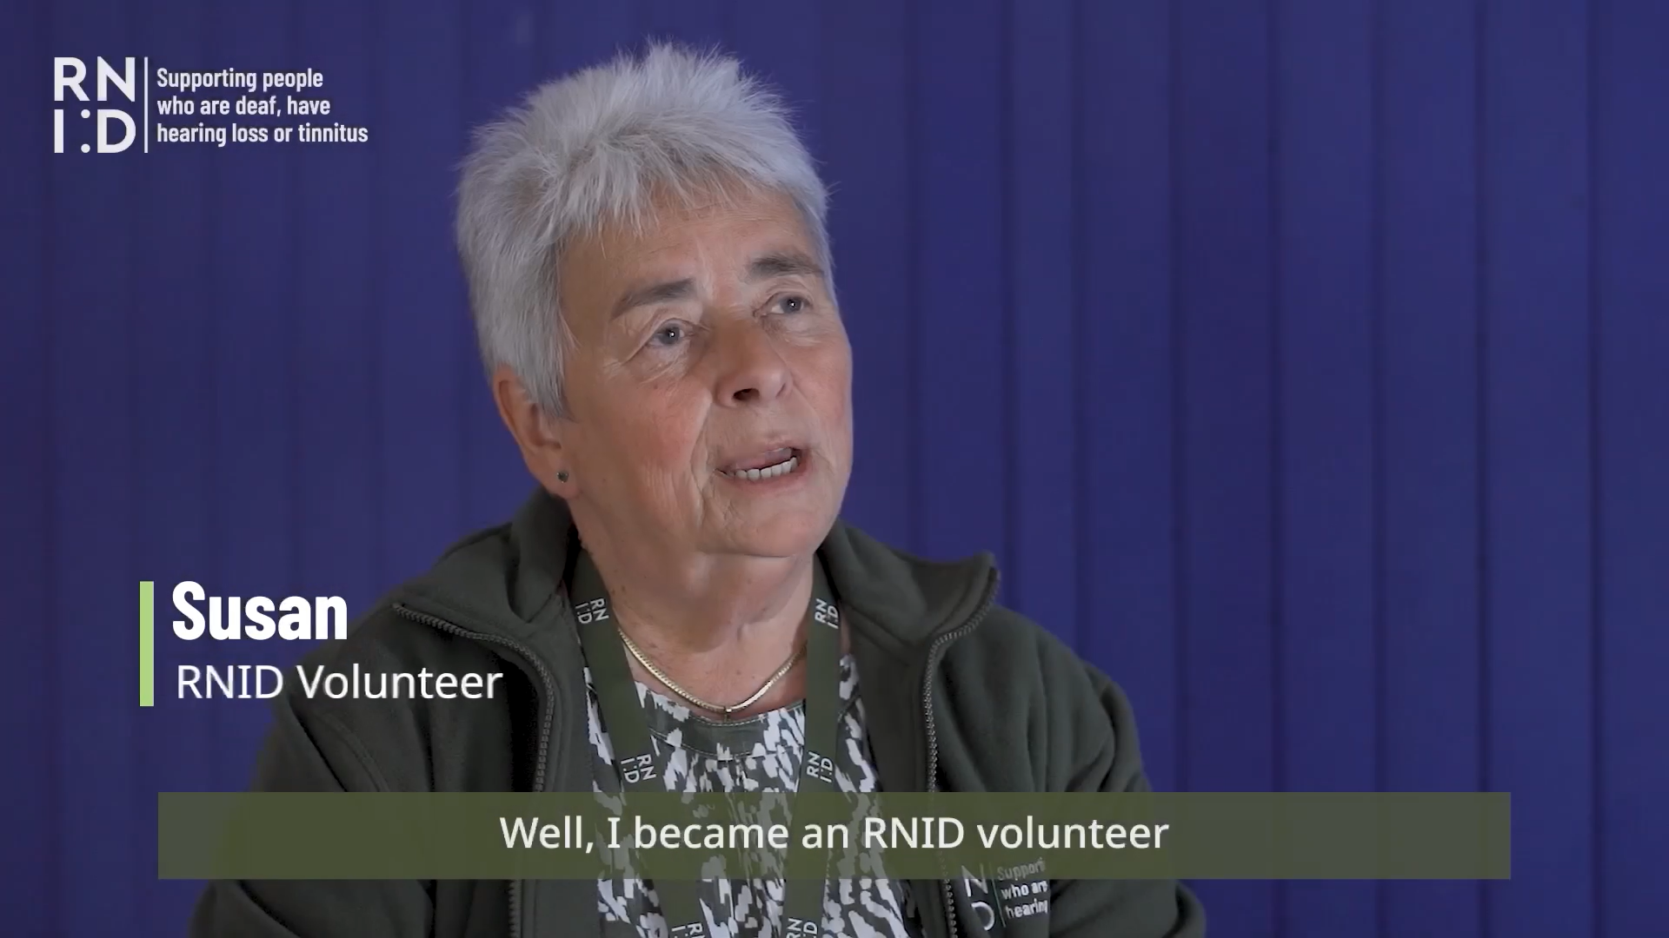
VOLUNTEER WITH US
Our volunteers make a valuable difference to people who are deaf, have hearing loss or tinnitus.
There are several ways to get involved, such as providing support to our communities in person at one of our RNID Near You sessions.
Last year our volunteers gave us over 16,000 hours of support.

Slide 31


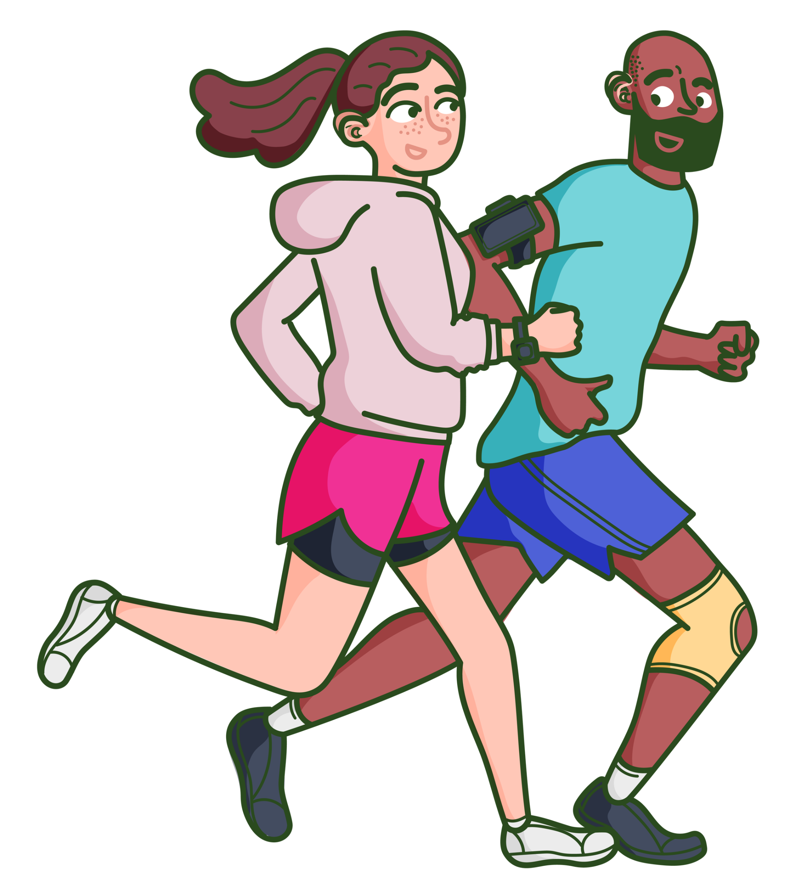
JOIN #TEAMRNID
Take on a challenge or organise an event and have fun while raising funds to support our vital work.

Slide 32


CAMPAIGN FOR CHANGE
Join our Campaigns Network!
Our current campaigns include:
Fight for accessible healthcare
“It does matter”
Subtitle it
BSL Act Now!
Earwax removal

Slide 33

JOIN OUR RESEARCH PANEL
Our Research Panel is a group of people with lived experience and people with close connections to our cause that take part in research on a regular basis.
They inform our work by helping us find out more about the experiences of deaf people and those with hearing loss or tinnitus.

Slide 34
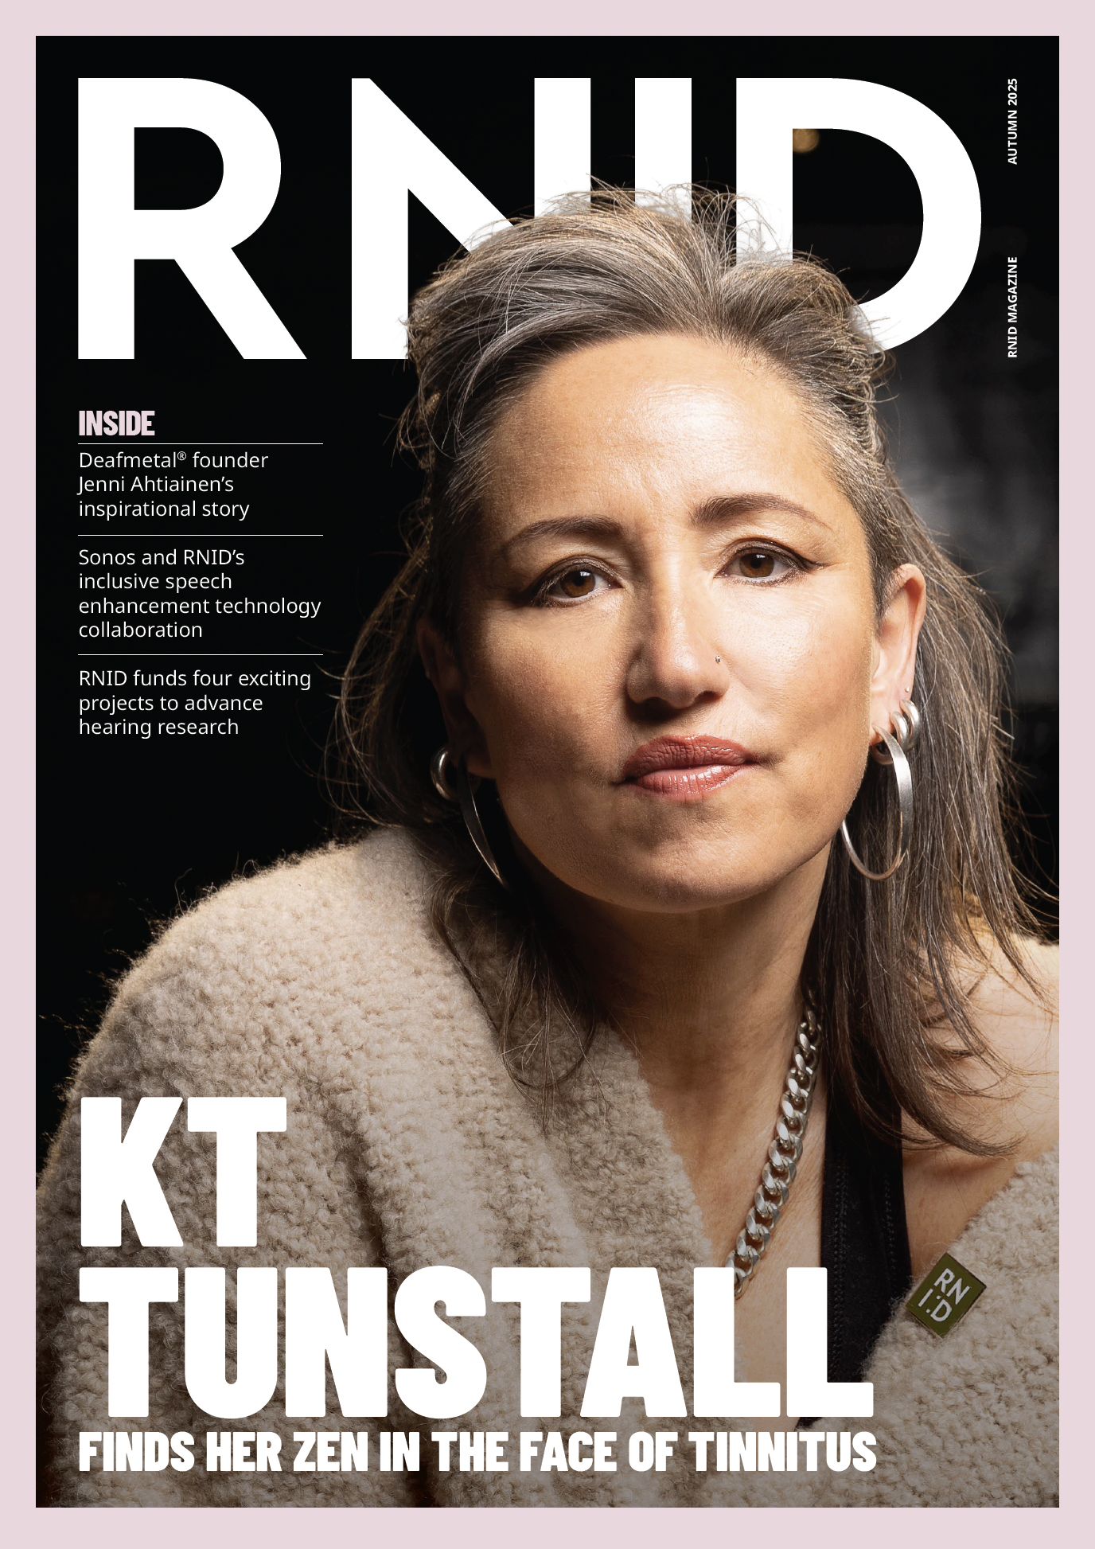
BECOME A MEMBER
Join RNID and as a member you will receive our magazine three times a year.
The magazine is filled with inspiring stories from the communities we support, as well as the latest news and updates from our research and campaigns.
Annual Membership costs just £27 a year, or £25 if you pay by Direct Debit.

Slide 35

“I used to have so many limiting beliefs, and this negativity was imparted on me growing up: ‘you’re deaf, you can’t do this, you can’t do that’. That created anxiety and limited my belief in myself.
I just needed to be in a community where I was empowered or encouraged. Now, I can empower and encourage others. ”
- Kori

Slide 36

THANK
YOU
RNID is the trading name of the Royal National Institute for Deaf People (RNID). Registered charity in England and Wales (207720), and Scotland (SCO38926). Registered company in England and Wales (454169). November 2025.

Slide 37
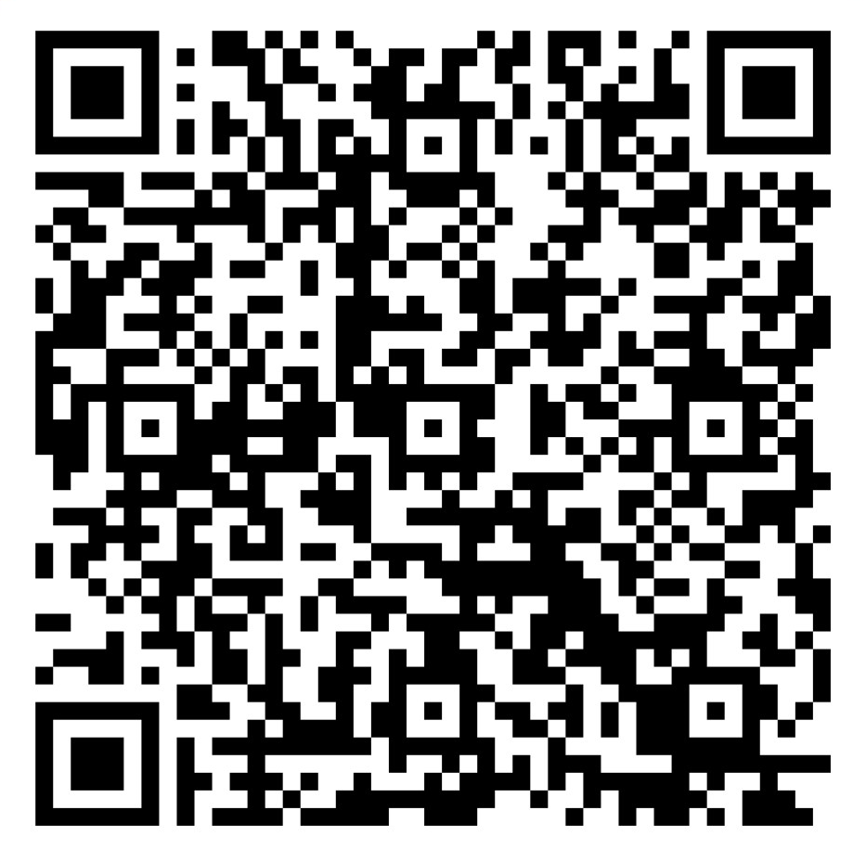
PLEASE SCAN
HERE TO SHARE
YOUR FEEDBACK

